Slide 1

How to Access Digital Course Materials

Slide 2
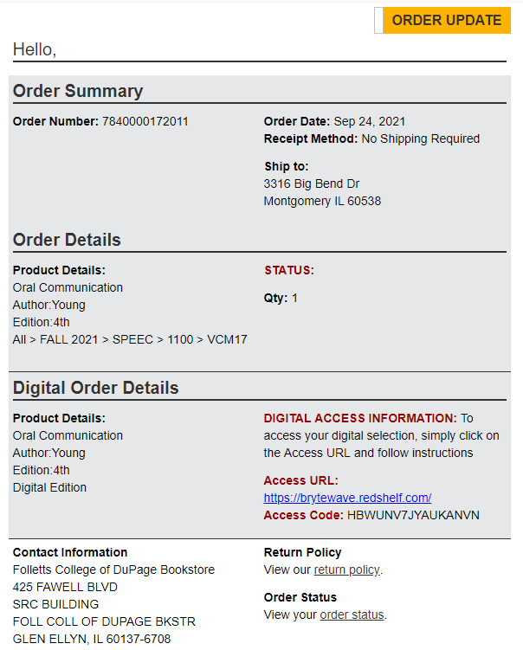
Purchased Online
Upon placing your order for a digital access code, you will receive two (2) emails. The second email will contain your digital information to access your code.

Slide 3
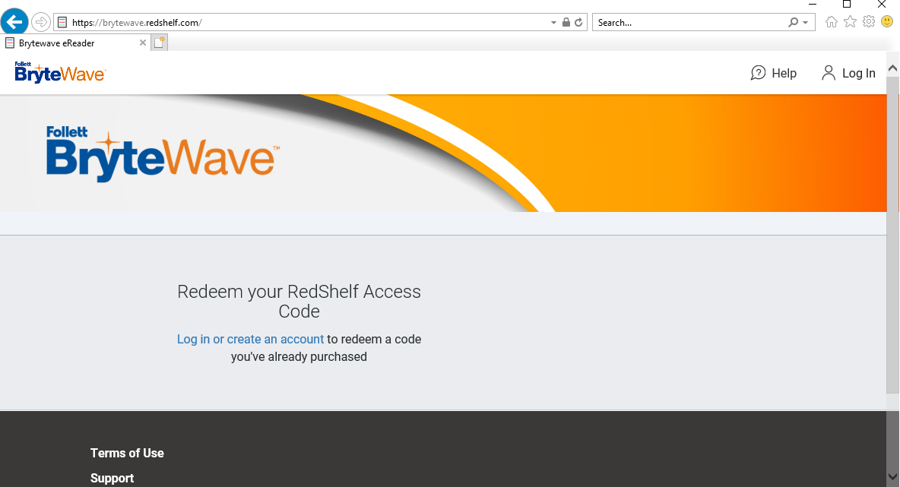
Purchased Online
Visit the URL provided in the 2nd email first

Slide 4
Purchased Online
Create an account if it’s your first visit, or log-in

Slide 5
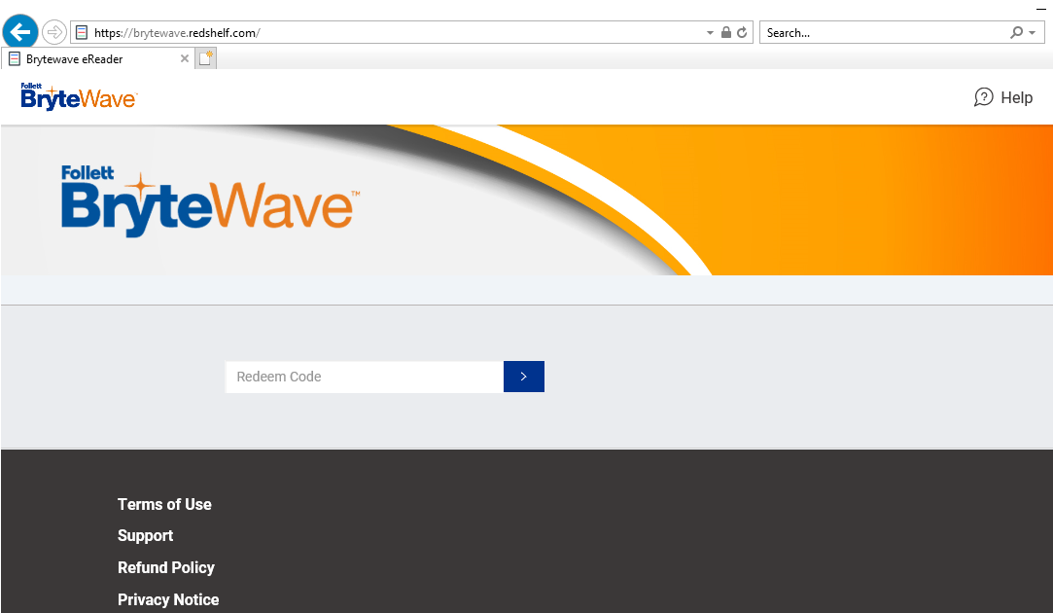
Purchased Online
After log-in or account creation, enter the PIN provided in the 2nd email, in the “Redeem” box.

Slide 6
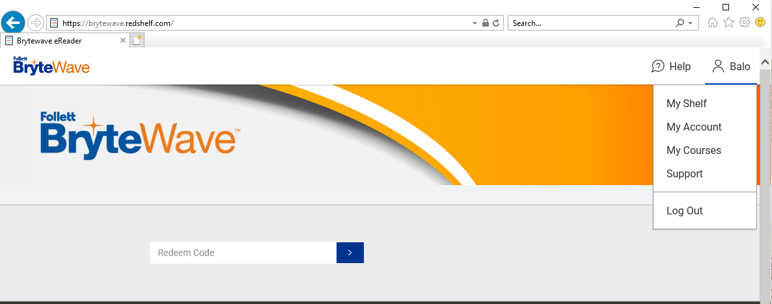
Purchased Online
Once redeemed, a new code will be generated in your “My Shelf” for the publisher’s site (Pearson, McGraw Hill, Cengage)

Slide 7
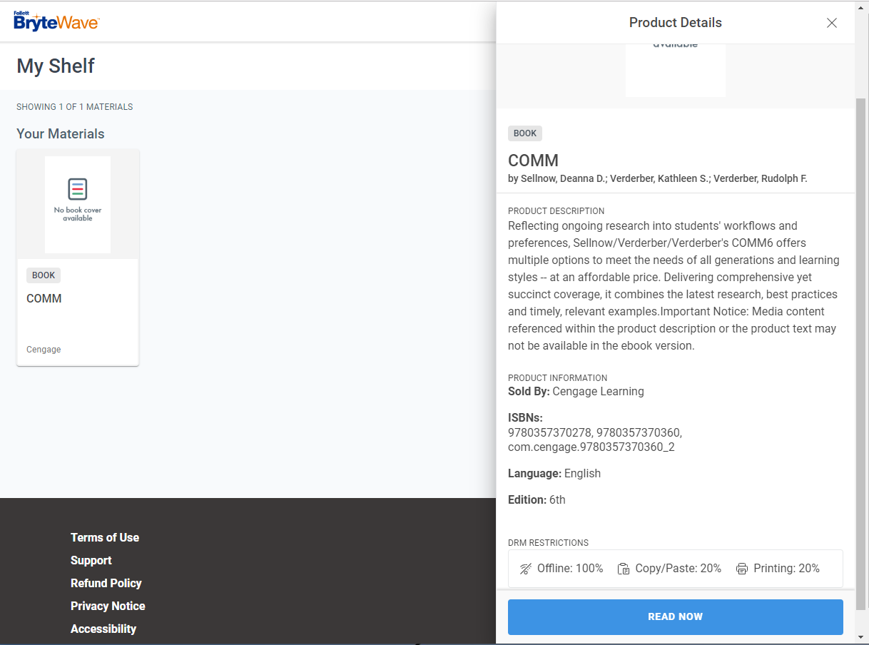
Purchased Online
In some cases, no new code will generate, and your book will be on your Shelf and available to begin reading right away.

Slide 8
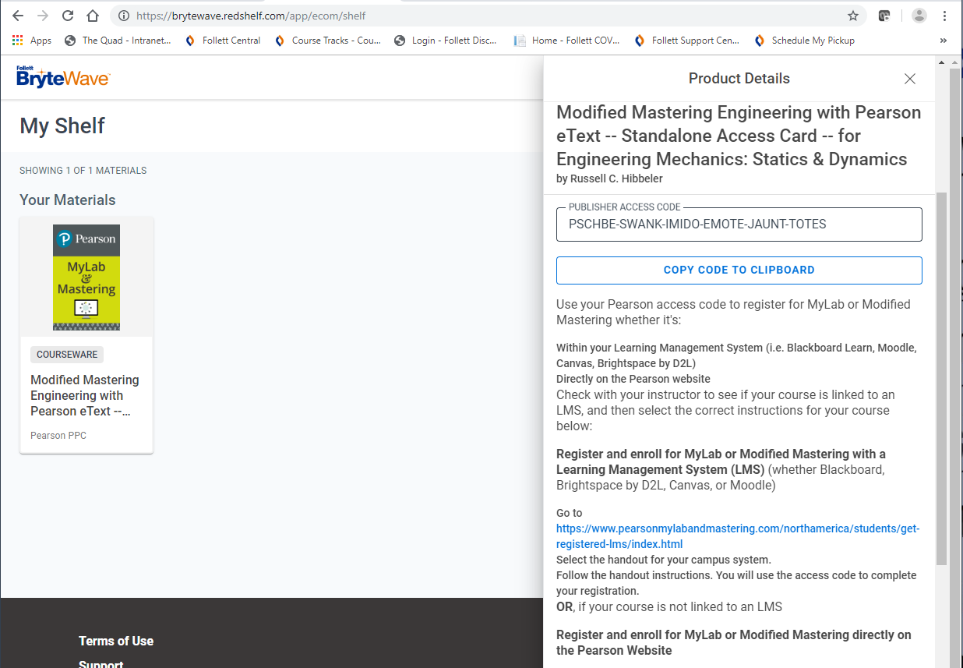
Purchased Online
If a new code is generated, go to the URL provided by your instructor and redeem your new code for access!

Slide 9
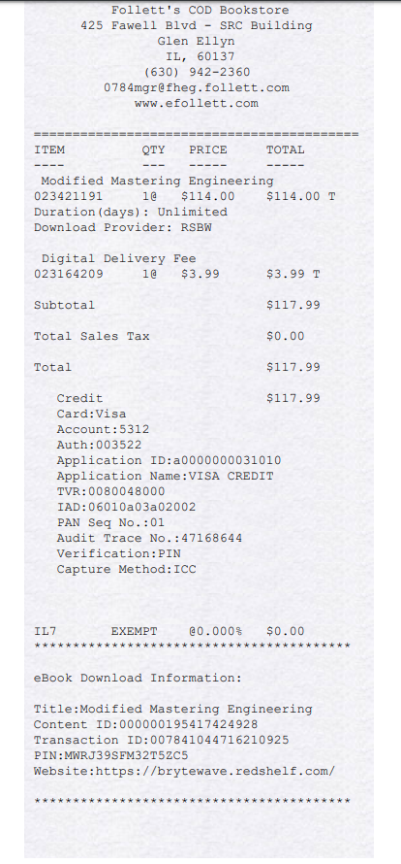
Purchased In Store
No problem! The code is in the center portion of the receipt. Just follow the same instructions once you locate it.
**Make sure to ask for a digital receipt at checkout too!**

Slide 10
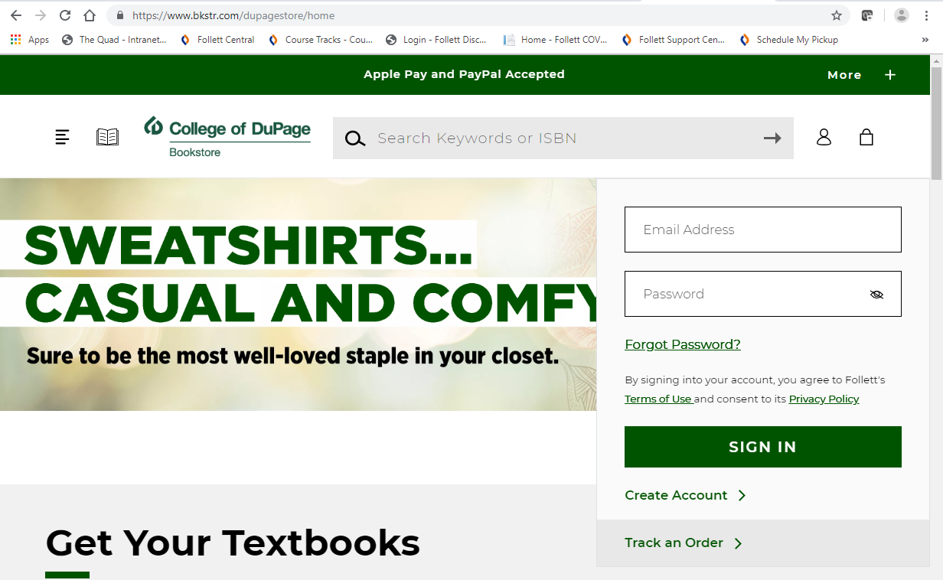
Best Practices
Create an account on the bookstore site too!

Slide 11
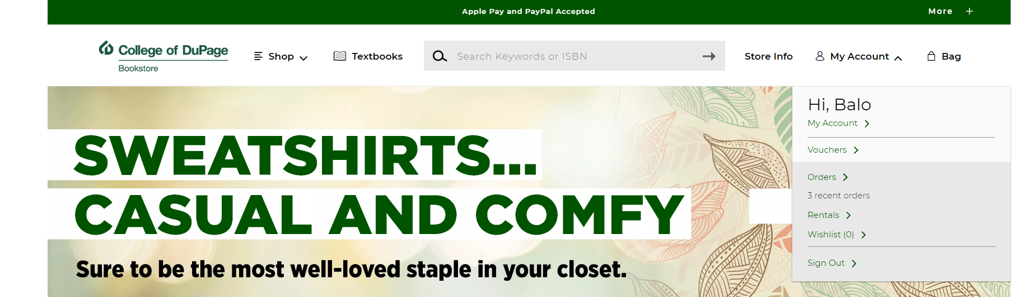
Best Practices
This will store all your digital codes for future use and easy access, under your order history!

Slide 12
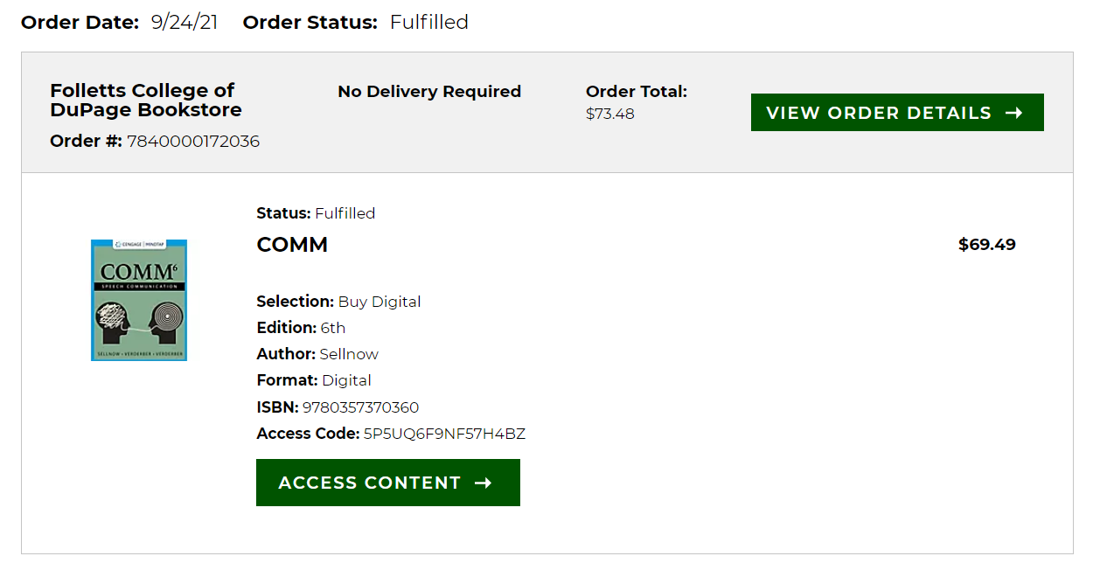
Best Practices
Now you can access them anytime and anywhere when you need it!

Slide 13
Need more Help?
Code not working? Technical support?
If you have difficulty accessing your eBook once you are logged on or experience any problems with the BryteWave site, you contact their customer service for support.
BryteWave Solve (Customer Service): https://brytewavesolve.zendesk.com/hc/en-us
If you need further support, please call BryteWave’s Customer Service line: 1-877-612-2233
We are always here to help too! 630-942-2361

