Slide 1
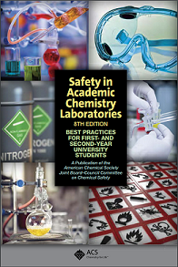
Laboratory Safety Awareness Training
Safety in Academic Chemistry Laboratories
Source: American Chemical Society (ACS) 8th Edition
Notes:
Providing a summary of information from the American Chemical Society 8th edition booklet, Safety in Academic Chemistry Laboratories.

Slide 2
Objective of today’s
Safety Awareness Training
Introduce you to the RAMP concept to maintain a safe lab environment
Provide procedures to follow to eliminate and/or minimize risks of hazards in the lab
Notes:
Objective of today’s of Safety Awareness Training
Introduce you to the RAMP concept to maintain a safe lab environment, and the
Provide procedures to eliminate and/or minimize risks of hazards in the lab.

Slide 3
The RAMP concept:
Recognize hazards
Assess the risks of hazards
Minimize the risks of hazards
Prepare for emergencies
Notes:
You can use the RAMP concept to work safely in labs:
Recognize hazards
Assess the risks of hazards
Minimize the risks of hazards
Prepare for emergencies

Slide 4
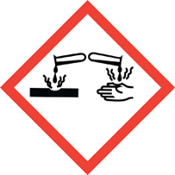




RAMP Concept - Recognize Hazards:
Hazard = Potential source of danger or harm.
In the lab you can encounter physical, health, or environmental hazards. Labels will have one or more of the Hazard Communication Pictograms.
Notes:
Recognize Hazards - A HAZARD is a potential source of danger or harm. If chemical hazards go unrecognized, unexpected events resulting in personal injury and or property damage can (and do) occur.
In the lab you can encounter physical, health, or environmental hazards. Labels will have one or more of the Hazard Communication Pictograms.

Slide 5
RAMP Concept - Recognize Hazards
Pictograms for physical or environmental hazards.
Flammable - Physical
Corrosive to metals - Physical
Toxic - Environmental
(Hazardous to the aquatic environment)
Notes:
In the lab you can encounter physical hazards or health hazards.
Hazard Communication Standard Pictograms
Flammable – Physical
Corrosive – Physical
Toxic – Environmental - Hazardous to the aquatic environment

Slide 6
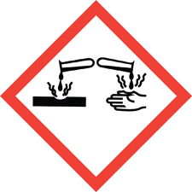
RAMP Concept - Recognize Hazards
Pictograms for Health hazards.
Skin corrosion, serious eye damage
Skin and Eye Irritant
Carcinogen, Specific Target Organ Toxin,
Aspiration hazard, Respiratory sensitizer,
Reproductive Toxin
Notes:
Health hazards.
Skin corrosion, serious eye damage
Skin and Eye Irritant
Carcinogen, Specific Target Organ Toxin,
Aspiration hazard, Respiratory sensitizer,
Reproductive Toxin

Slide 7

RAMP Concept - Recognize Hazards
Chemical containers will display symbols to warn users of danger.
Hazards Identification (for Acetone)
2.2 GHS Label elements, including precautionary statements
Pictograms
Signal word: Danger
Hazard Statement(s)
H225 Highly flammable liquid and vapor
H319 Causes serious eye irritation
H336 May cause drowsiness or dizziness
Notes:
Two signal words Danger or Warning
Danger – will cause harm
Warning – may cause harm
Acetone – main ingredient in Nail Polish Remover,

Slide 8
RAMP Concept - Recognize Hazards
Chemical containers will display symbols to warn users of danger.
Hazards Identification (for Hydrochloric acid, 6M-12M – Concentrated)
2.2 GHS Label elements, including precautionary statements
Pictograms
Signal word: Danger
Hazard Statement(s)
H314+318 Causes severe skin and eye damage
H332+H302 Harmful if swallowed or inhaled
Precaution Statements
P261 Do not breathe mist, vapors or spray
P270 Do not eat, drink or smoke when using this product
Notes:
Two signal words Danger or Warning
Danger – will cause harm
Warning – may cause harm
Hydrochloric acid – 6M-12M Concentrated

Slide 9
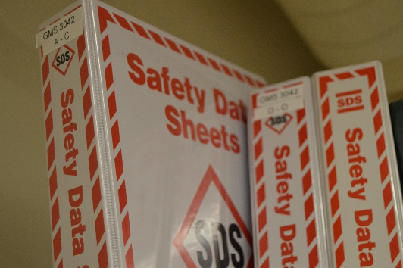
RAMP Concept - Recognize Hazards
Your professor will provide you with the safety information you need to know before your start conducting your lab experiment.
To learn more about a specific chemical. Read it’s Safety Data Sheet (SDS).
It contains hazard statements, and precautions that can be followed to work safety with the material.
Notes:
Your professor will provide you with the safety information you need to know before your start conducting your lab experiment.
Your experiments have been analyzed and procedures have been developed to provide you information you can use to conduct the experiment safely.
Just like the chemicals we use at home- containers will have safety information
Oil – Avoid prolonged or repeated skin contact, thoroughly wash exposed area with soap and water.
Deep Woods Off! – Caution - Physical & Chemical Hazards – Flammable – Contents under Pressure, Keep away from Heat, Sparks, and open flame
Zep Stainless Steel Polish – Danger – Flammable contents under pressure, Sensitizer
To learn more about a specific chemical. Read it’s Safety Data Sheet (SDS).
It contains 16 sections and contains hazard statements, and precautions that can be followed to work safety with the material.
It contains hazard statements, and precautions that can be followed to work safety with the material.

Slide 10
RAMP Concept - Recognize Hazards
Precautionary Statements for all chemicals:
P103 Read label before use.
P202 Do not handle until all safety precautions have been read and understood.
P233 Keep container tightly closed.
P261 Avoid breathing dust/fume/gas/mist/vapor/spray.
P262 Do not get in eyes, on skin, or on clothing.
P264 Wash skin thoroughly after handling.
P280 Wear protective gloves/protective clothing/eye protection/ face protection.
P281 Use personal protective equipment as required.
Special circumstances/considerations:
P263 Avoid contact during pregnancy/while nursing.
Notes:
Some of these precautionary statements will be covered under procedures to minimize risks when working with hazardous chemicals.

Slide 11
RAMP Concept - Assess the Risk of hazards
RISK = Combination of:
Impact of Risk the consequences if it occurs,
Probability of Risk likelihood of an unwanted incident occurring (0 – 100%), it’s related to the frequency of exposure to the hazard.
Notes:
RISK = Combination of:
Impact of Risk the consequences if it occurs,
Probability of Risk likelihood of an unwanted incident occurring (0 – 100%), it’s related to the frequency of exposure to the hazard.

Slide 12
RAMP Concept - Assess the Risk of hazards
Items to Assess risk include the extent of exposure:
Dose – (strength) diluted, concentrated
Duration – (how long it lasts) seconds, minutes, hours
Frequency – (how any times) one time, several times
Route – (how it affects your body) skin, eyes, mucus membranes, lungs
Inherent Toxicity - acute (Single exposure),
- chronic (Repeated or Long-term exposure)
Procedures can Minimize these items to the lowest amount possible.
Notes:
Items to assess risk include the extent of exposure:
Dose – diluted, concentrated (strength), example 1 M to 0.1 M decrease of ten fold
Duration – seconds, minutes, hours (how long it lasts)
Frequency – one time, several times a day (how many times)
Route – skin, eyes, mucus membranes, lungs (how it affects your body)
Inherent Toxicity – Acute (Single exposure), or Chronic (Repeated or Long-term exposure)
Procedures can Minimize these items to the lowest amount possible.

Slide 13
RAMP Concept – Minimize the risks of hazards
Procedures to Minimize the risks of hazards in the laboratory
Store books, backpacks, coats etc. on side benches.
No eating or drinking or applying cosmetics in lab
Safety glasses or goggles are required at all times.
Wearing clothing that cover the skin (shorts past knee)
Shoes - No open toes or sandals, (shoes with openings)
Tie back or constrain long hair
Move carefully and slowly, do not startle others
Keeping containers tightly closed when not in use
Proper labeling containers or glassware
Read the procedure before coming to lab
Follow instructions for proper disposal of lab waste – ask professor if unsure.
Notes:
Procedures to MINIMIZE the risks of hazards in the laboratory include:
Store books, backpacks, coats etc. on side benches.
No eating or drinking or applying cosmetics in lab
Safety glasses or goggles are required at all times.
Wearing clothing that cover the skin (shorts past knee)
Shoes - No open toes or sandals, (shoes with openings)
Tie back or constrain long hair
Move carefully and slowly, do not startle others
Keeping containers tightly closed when not in use
Proper labeling containers or glassware
Read the procedure before coming to lab
Follow instructions for proper disposal of lab waste – ask professor if unsure.

Slide 14
Procedures (Cont.)
Equipment Care
Clean balances (use brushes for powders and crystals), and hotplates (damp paper towel) after use (if spills occurred).
Final Cleanup
Clean up your work area, wipe down workstation, clean glassware, and carefully place your items in your drawer.
Last Item
Always wash your hands before leaving lab (right before collecting your personal items)
Notes:
Procedures to Minimize the risks of hazards in the laboratory - continued:
Equipment Care
Clean balances (use brushes for powders and crystals), and hotplates (damp paper towel) after use (if spills occurred).
Final Cleanup
Clean up your work area, wipe down workstation, clean glassware, and carefully place your items in your drawer.
Last Item
Always wash your hands before leaving lab (right before collecting your personal items)

Slide 15
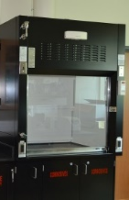
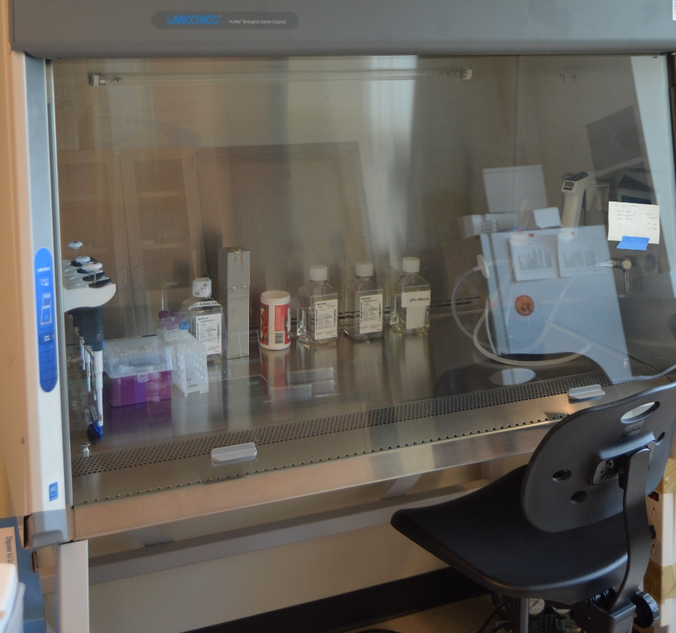
RAMP Concept – Minimize the risks of hazards
Examples of Engineering Controls to Minimize the risk of chemical exposure from fumes or mists to your respiratory system. (Mucus membranes, airway and lungs)
Fume Hoods and Biohazard Safety Cabinets
Notes:
Examples of Engineering Controls
Fume Hoods - to protect your lungs from hazardous fumes.
Biohazard Safety Cabinets – to protect you from biohazards materials, it provides a sterile environment.

Slide 16
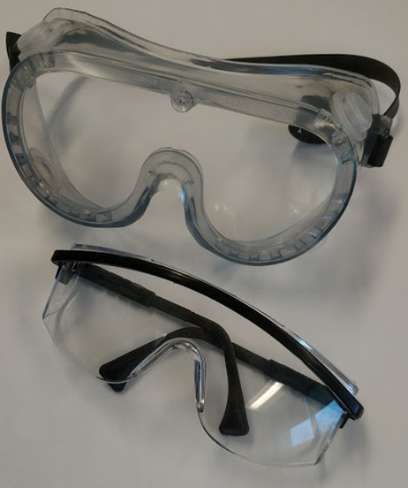
RAMP Concept – Minimize the risks of hazards
The use, function and selection of personal protective equipment to minimize the risk of chemical exposure to your eyes.
Eye protection: safety glasses with side shields or goggles required when using glassware, or working with chemicals.
Goggles provide the most
protection from impact
and chemical splash hazards.
Notes:
The use, function and selection of personal protective equipment.
Eye protection: safety glasses with side shields or goggles required when using glassware, or working with chemicals. Goggles provide the most protection from impact and chemical splash hazards.

Slide 17
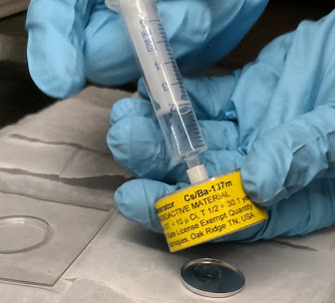
RAMP Concept – Minimize the risks of hazards
The use, function and selection of personal protective equipment to minimize the risk of chemical exposure to your hands.
Gloves: chemical resistant Nitrile gloves are available.
Wash off any contamination
Change as soon as feasible
to do so
Notes:
Gloves: chemical resistant Nitrile gloves are available. Remember all gloves have a chemical break through point; always wash off any contamination as soon as it is feasible to do so.
No Glove is Chemical Proof

Slide 18
RAMP Concept – Minimize the risks of hazards
The use, function and selection of personal protective equipment to minimize the risk of chemical exposure to your hands.
Gloves cont.
Breakthrough times (BT) for commonly used chemicals
Source: VWR NORTH Hand Protection Chemical Resistance Guide
No glove is chemical proof, gloves have limitations…
Chemical Name | BT Nitrile
Acetic acid 38 % | 38 min
Ammonium hydroxide 29% | 2.2 hrs
Hydrochloric acid | > 6 hrs
Nitric acid 10% | > 8 hrs
Sodium hydroxide 50% | > 8 hrs
Notes:
Gloves: chemical resistant Nitrile gloves are available. Remember all gloves have a chemical break through point; always wash off any contamination as soon as it is feasible to do so.
Acetic acid 38 % - 38 min
Ammonium hydroxide 29% - 2.2 hrs
Hydrochloric acid - >6 hrs
Nitric acid 10% - > 8 hrs
Methanol - 32 min
Sodium hydroxide 50% - > 8 hrs
Toluene - 11 min
Xylene - 21 min
No Glove is Chemical Proof , gloves have limitations -
examples in advanced Chemistry - Toluene 11 min; Xylene 21 min

Slide 19
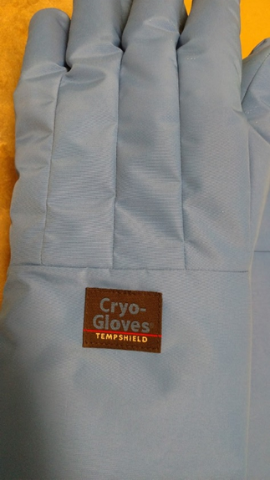
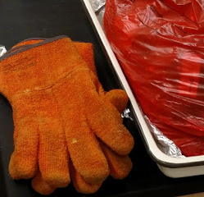
RAMP Concept – Minimize the risks of hazards
The use, function and selection of personal protective equipment to minimize the risk from extreme temperatures.
Specialty Gloves: heat resistant gloves are available for removing items from the autoclave and drying ovens. Cryogenic gloves are available for refilling liquid nitrogen.
Heat resistant gloves
Cold resistant gloves
Notes:
Specialty Gloves: heat resistant gloves are available for removing items from the autoclave and drying ovens. Cryogenic gloves are available for refilling liquid nitrogen.

Slide 20
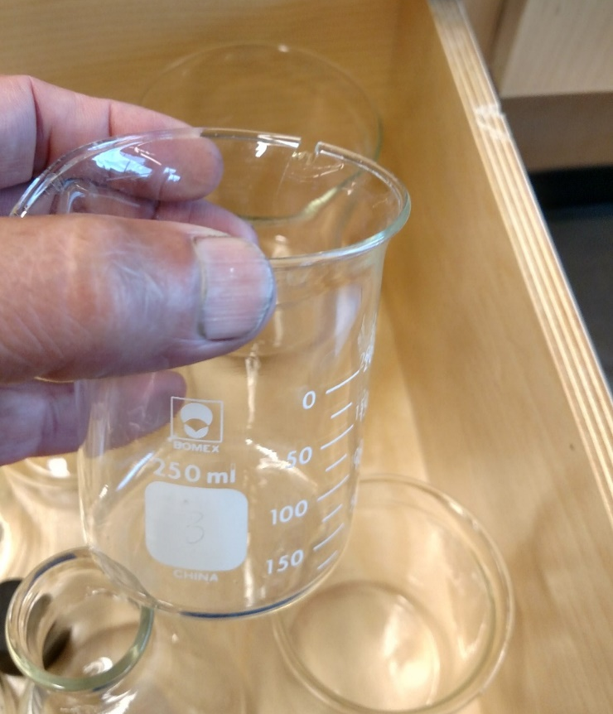
RAMP Concept – Minimize the risks of hazards
Inspection of glassware before using, to minimize the risk of cuts or lacerations to skin:
Always check glassware for chips, hairline cracks, star cracks on bottom of test tubes.
Chipped beaker
Ask your TA for a replacement.
Notes:
Inspect glassware before using -
If flawed glassware is heated there is a greater chance that if will fail and break spilling its contents.
Ask your TA for a replacement.

Slide 21
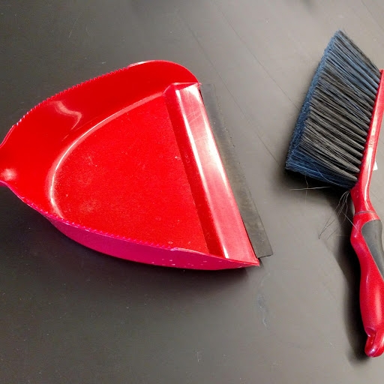
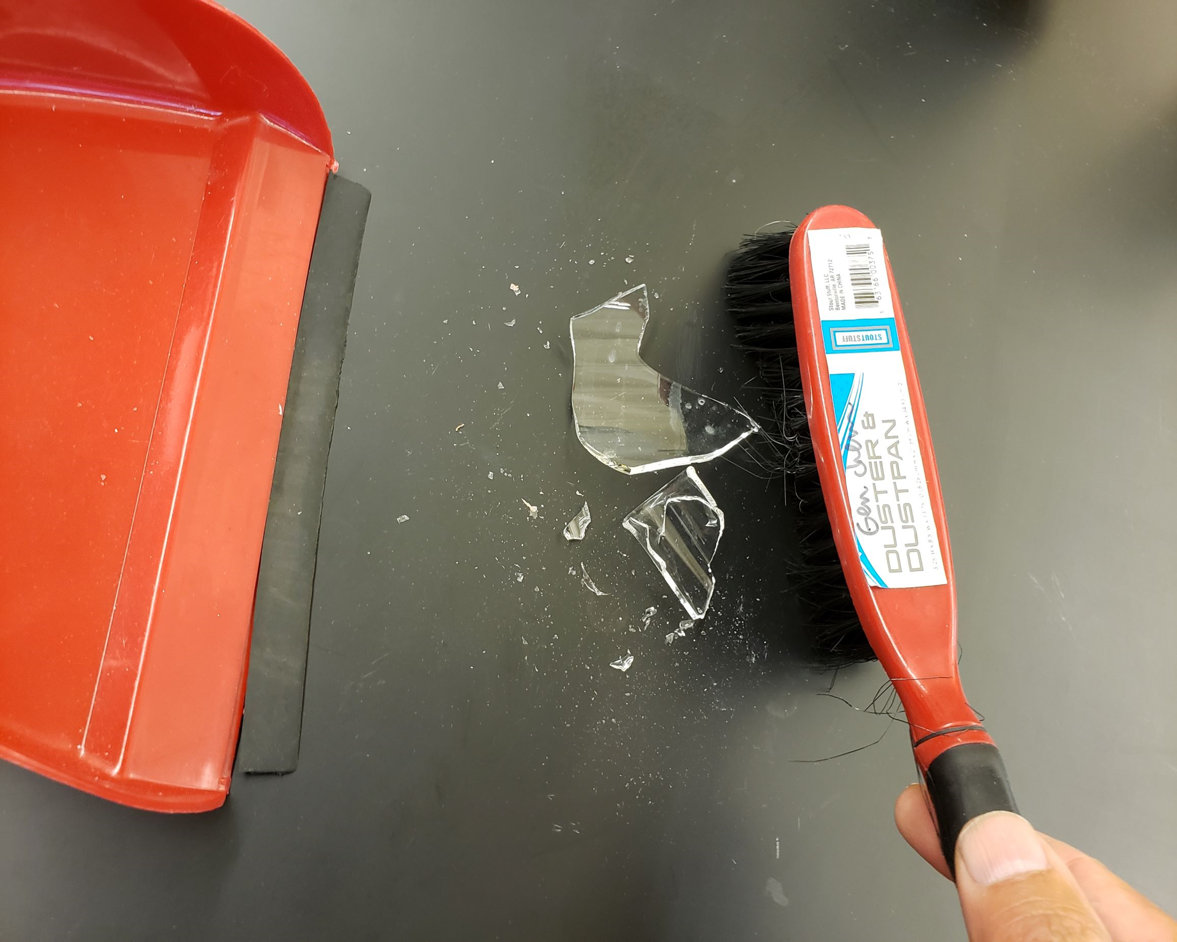
RAMP Concept – Minimize the risks of hazards
To minimize the risk of cuts or lacerations to skin:
Follow procedures for broken or flawed glassware disposal
Flawed (cracks, chips) notify a TA for replacement
Notify a TA for cleanup of broken glass
Notes:
Get a sample from container
Broken or flawed glassware disposal:
For Flawed glassware – star cracks in test tubes, cracks or chips in glassware – notify your TA for a replacement
Notify a TA for cleanup of broken glass
The TA will use a barrier device, (no bare hands for small broken pieces) small dust broom, or damp (doubled thickness) paper towel.
Place all pieces and paper towel used for final cleanup into broken glass storage container.

Slide 22

Remember no bare hands!
Notes:
Remember no bare hands!

Slide 23
Notes:
Glassware Safety
Glassware handling – use two hands to transport glassware. Place one hand one the side and one hand underneath.

Slide 24
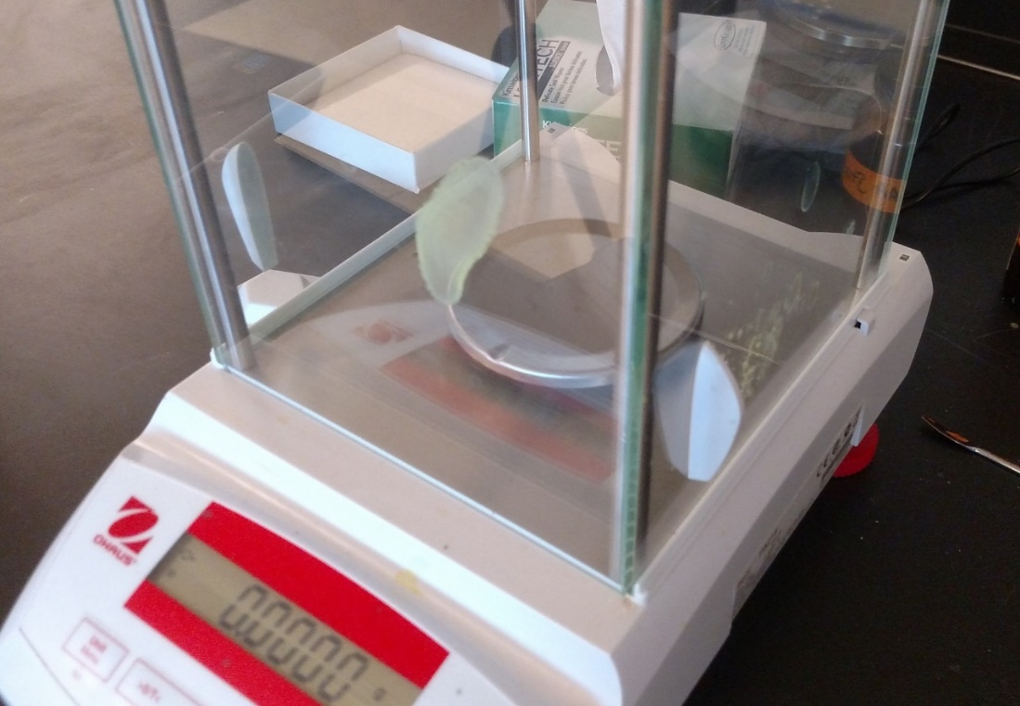
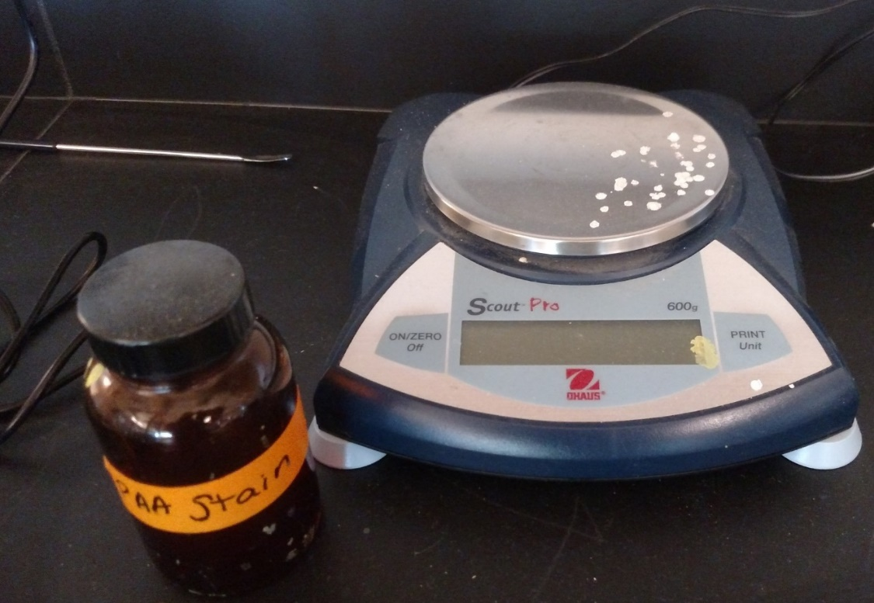
RAMP Concept – Minimize the risks of hazards
Minimize the risk of chemical exposure to hands
Clean up Balance pans after use
Please leave it as clean or cleaner than you found it.
Notes:
Clean up balance pans if you missed your weigh boat: Please use the brush to remove spilled powders, also wipe up residue using a damp paper towel to clean balance and countertop.
If corrosive material is left on the balance pan it will start to corrode the finish, it will also start to discolor the display and plastic parts.

Slide 25
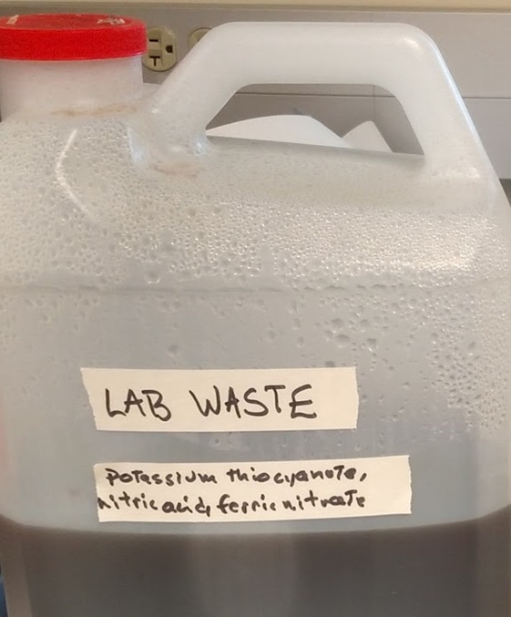
RAMP Concept – Minimize the risks of hazards
Proper disposal - capture all flammable, toxic, or corrosive wastes. The Professor will give special instructions before performing experiment.
Pour wastes into a designated labeled container in the fume hood.
Most General CHEM lab waste can
usually be neutralized and treated.
Notes:
Chemical waste management procedures at St. Norbert College
Proper disposal - capture all flammable, toxic, or corrosive wastes. The Professor will give special instructions before performing experiment.
The most common method will be to pour wastes into a labeled container in the fume hood.
Most General CHEM lab waste can
usually be neutralized and treated.

Slide 26
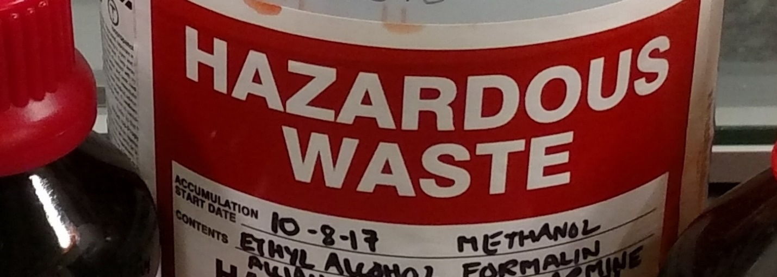
RAMP Concept – Minimize the risks of hazards
Minimize the risk of chemical exposure (explosions, container failure due to incompatible wastes being combined)
Chemical waste management procedures at St. Norbert College for upper level classes.
Proper disposal - capture all flammable, toxic, or corrosive wastes. The Professor will give special instructions before performing experiment.
Pour wastes into a designated labeled container in the fume hood.
Notes:
Chemical waste management procedures at St. Norbert College for upper level classes.
Proper disposal - capture all flammable, toxic, or corrosive wastes. The Professor will give special instructions before performing experiment.
The most common method will be to pour wastes into a labeled container in the fume hood. Please fill out a label or tag with the name the waste material.
Large quantities of bases or acids will be collected in a 5 gallon pail in the fume hood.

Slide 27
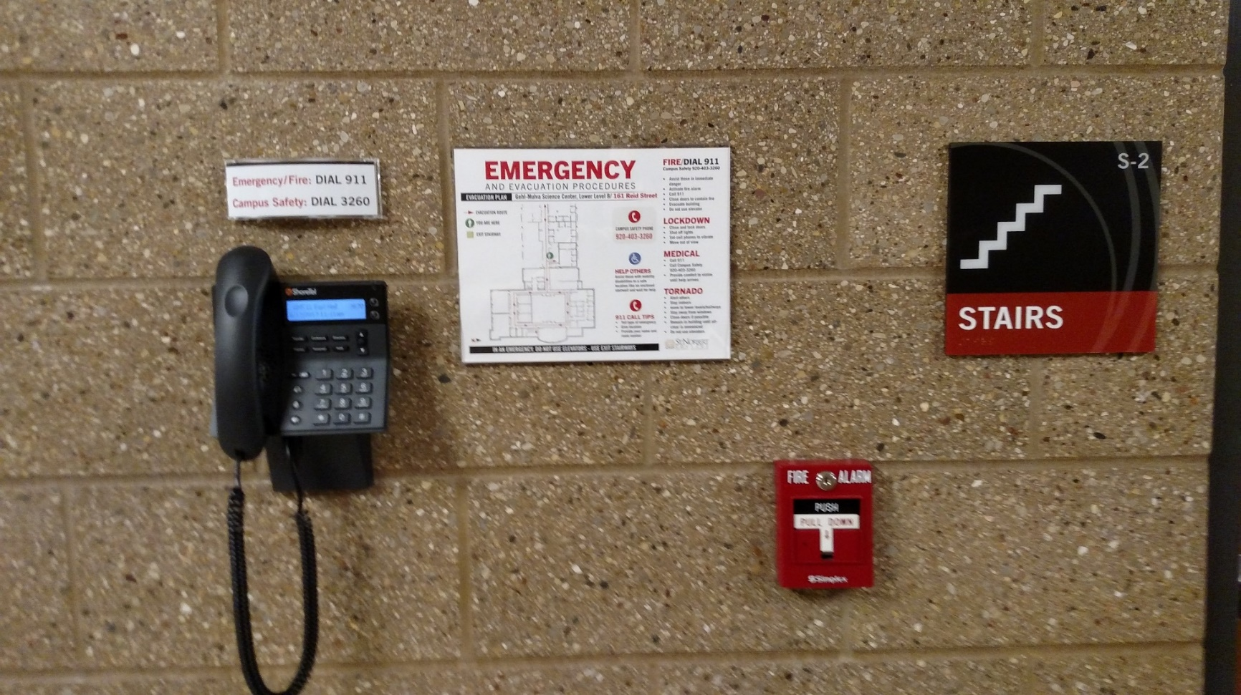
RAMP Concept – Prepare for Emergencies
4.3.7 Emergency procedures for fire, injury, chemical exposure, and chemical spill situations.
Notes:
Emergency phones and maps are located in the hallways near exits. There are also fire alarm pull stations to use in case of a fire and the alarm is not already sounding.

Slide 28
RAMP Concept – Prepare for Emergencies
Fire prevention and fire emergency response:
Prevention -
Use hotplates or sand baths instead of Bunsen burners, if possible, to heat liquids.
Maintain clearance between hot surfaces and flammable materials.
Emergency Response -
Fire alarm during class, turn off equipment and calmly proceed to the nearest exit.
Fire in lab,
Turn off heat source; smother flames if possible
Alert professor and TA - Exit the lab warning others as you follow the exit route.
Notes:
Fire prevention and fire emergency response:
Prevention - Use hotplates or sand baths instead of Bunsen burners, if possible, to heat liquids.
Maintain clearance between hot surfaces and flammable materials.
Emergency Response -
If there is a fire alarm during class, turn off equipment, like hot plates, or Bunsen burners, and calmly proceed to the nearest exit.
In case of fire in lab:
Turn off heat source; smother flames if possible by pouring clay or sand from spill control container over material.
Alert professor and TA - Exit the lab warning others as you follow the exit route.

Slide 29
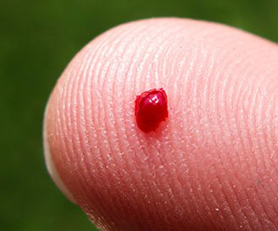
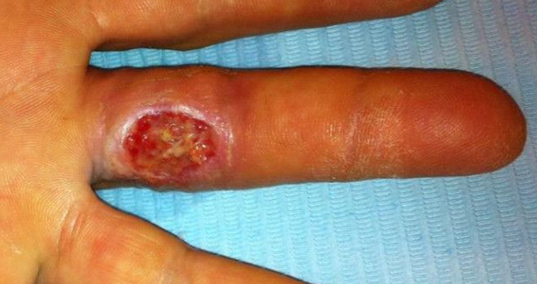
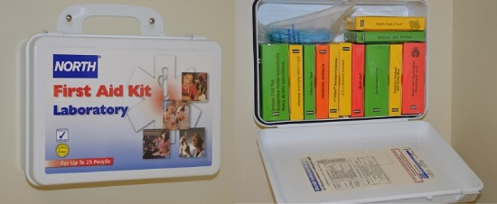
RAMP Concept – Prepare for Emergencies
Prepare for emergencies to minimize harm or injury
Always report injuries to your professor
Know where the First Aid Kit is Located.
Notes:
Prepare for emergencies by knowing what steps to take to MINIMIZE harm or injury.
Always report incidents as soon as possible to your professor
Know where emergency equipment is located in the laboratories
First Aid Kit
Example of a finger needle stick, and 3rd degree formic acid chemical bur
Injuries: The main goal of reporting injuries is to eliminate hazards, and to prevent future injuries from happening.

Slide 30
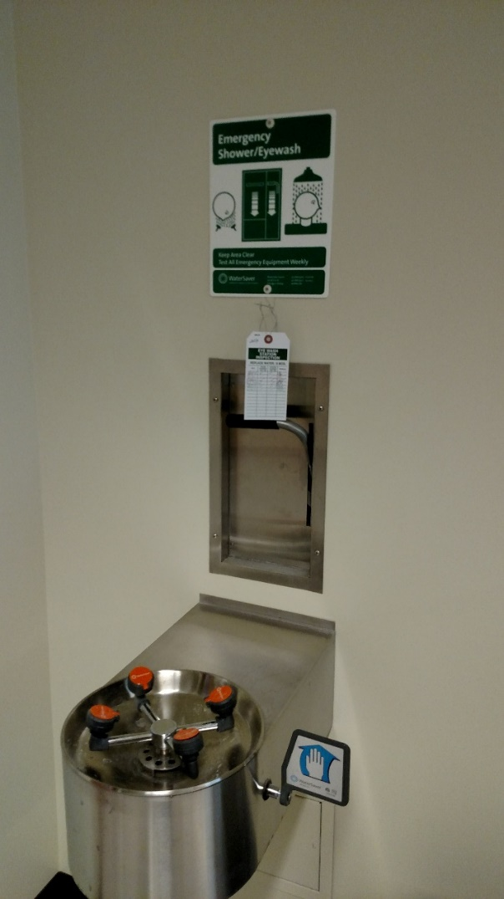
RAMP Concept – Prepare for Emergencies
4.3.7 Emergency procedures for Chemical exposure
Eyewash/Shower: location and use.
Wear your eye protection – save your eyesight.
Always maintain unobstructed access to emergency equipment!
Precautionary Statements - response
IF ON SKIN (or hair): Remove/Take Off immediately all contaminated clothing. Rinse skin with water/shower.
IF IN EYES: Rinse cautiously with water for several minutes. Remove contact lenses, if present and easy to do. Continue rinsing.
IF INHALED: Move to fresh air.
Notes:
If you are wearing your safety glasses with side shields or goggles during laboratory experiments this shouldn't have to be used for washing chemicals or other contaminates out your eyes.
Precautionary Statements -response
P303 + P361 + P353 IF ON SKIN (or hair): Remove/Take Off immediately all contaminated clothing. Rinse skin with water/shower.
P304 + P340 IF INHALED: Remove victim to fresh air and keep at rest in a position comfortable for breathing.
P305 + P351 + P338: IF IN EYES: Rinse cautiously with water for several minutes. Remove contact lenses, if present and easy to do. Continue rinsing.

Slide 31
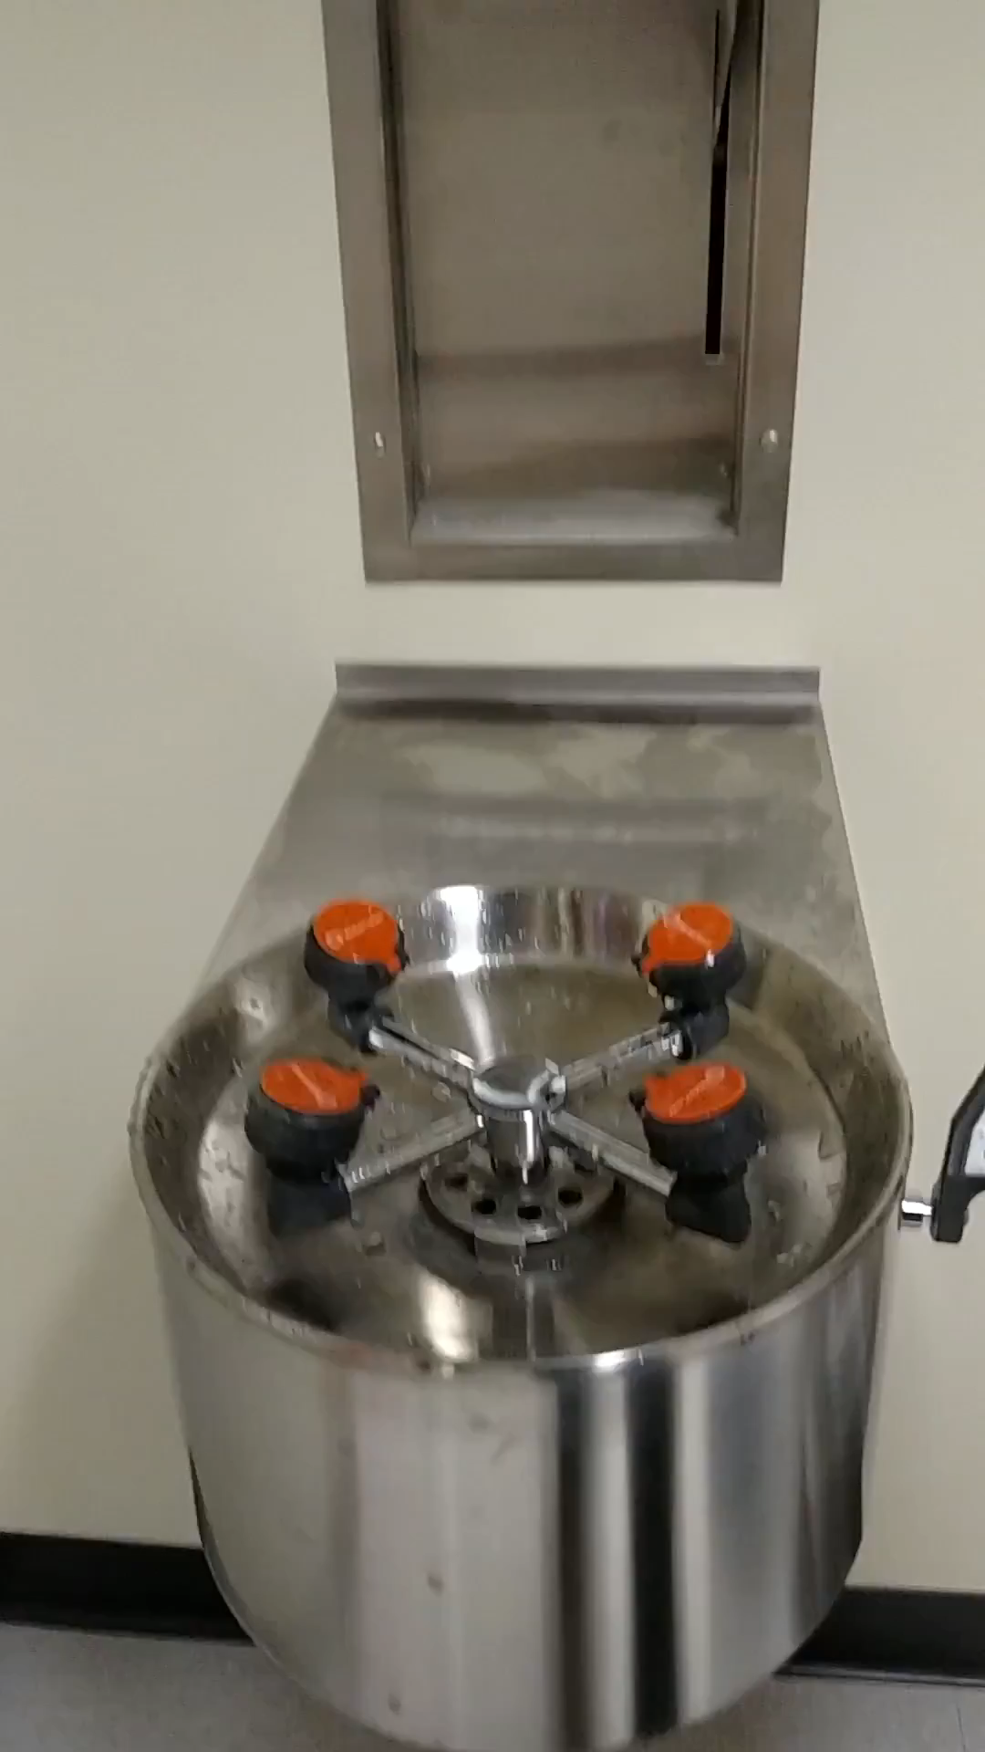
Easy one hand operation, hold eye lids open while using eyewash, natural reflex is to blink when water hits your eyes.
Notes:
Video – Eyewash Operation

Slide 32
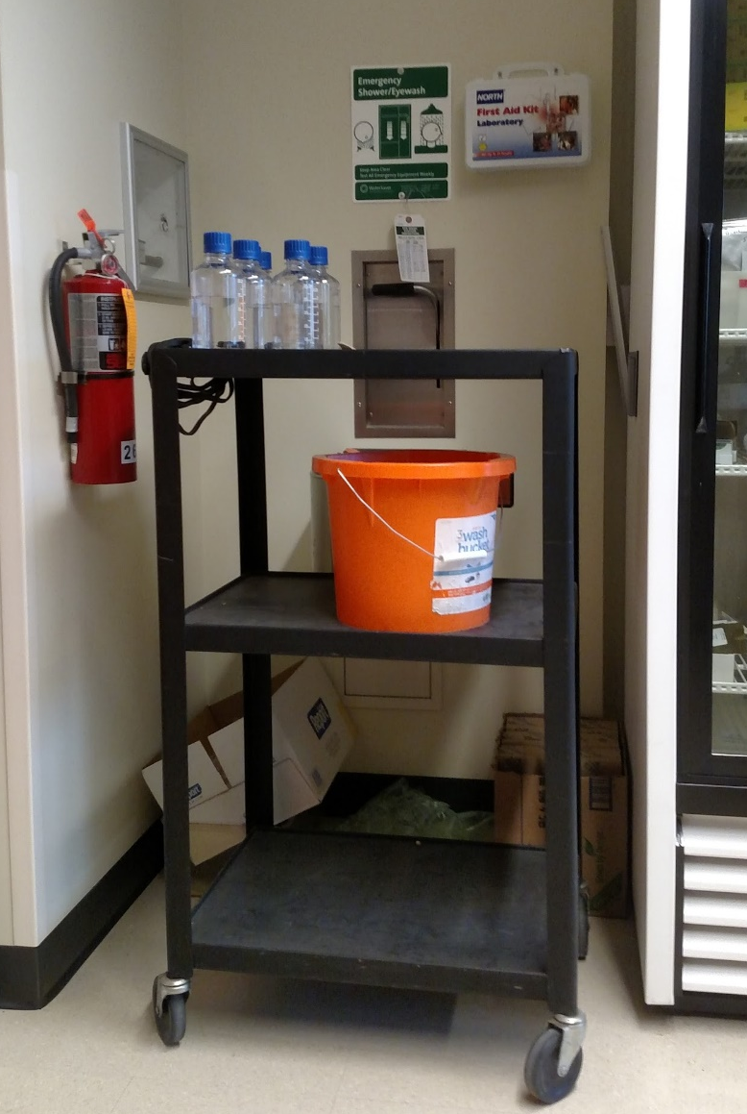
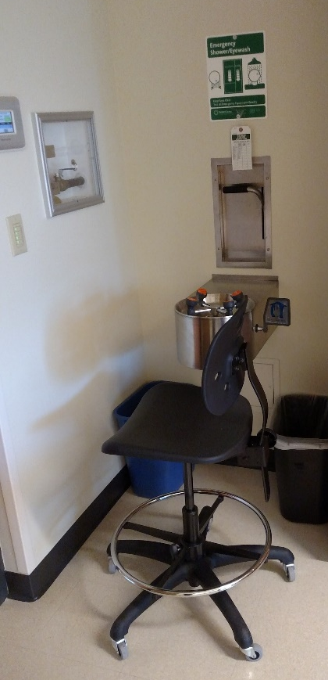
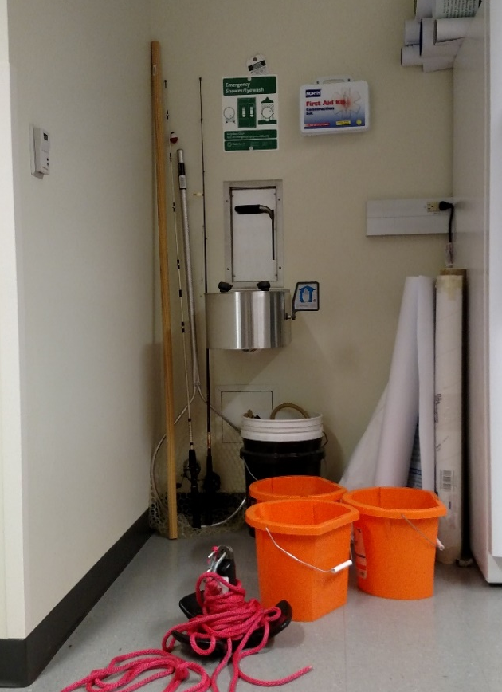
RAMP Concept – Prepare for Emergencies
4.3.7 Emergency procedures Access to Emergency Equipment
Always maintain unobstructed
access to emergency equipment!
Do not block access with carts,
chairs, or anything else.
If you see this… please clear area before starting to work in lab.
Notes:
Always maintain unobstructed access to emergency equipment! (Click)
Do not block access with carts, (Click) chairs, (Click) or anything else.
If you see this… please clear area before starting to work in lab.

Slide 33
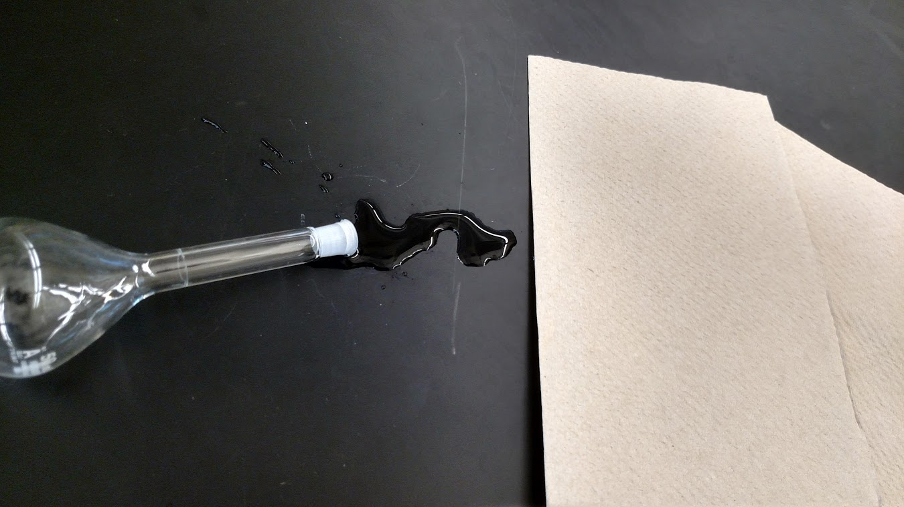
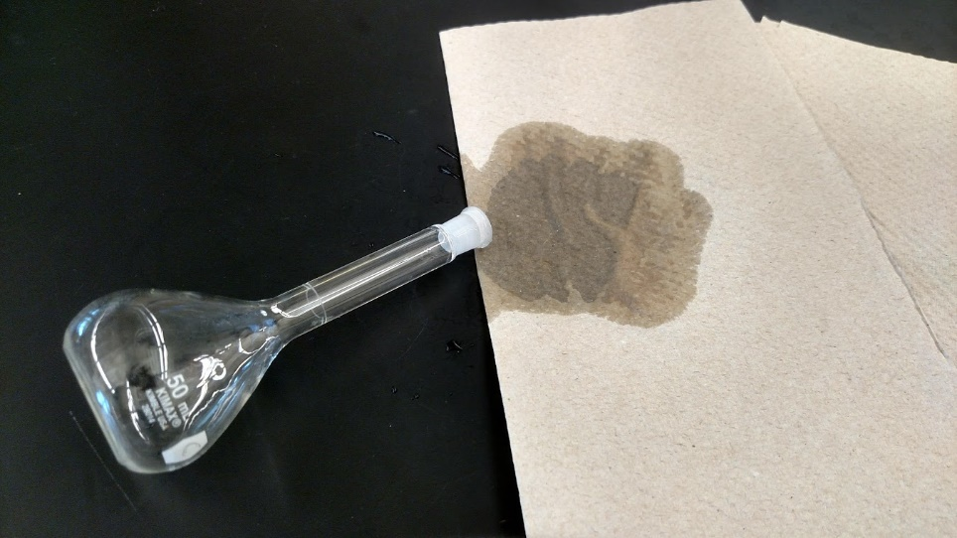
RAMP Concept – Prepare for Emergencies
4.3.7 Emergency procedures for Chemical Spills
Small simple spills: less than a test tube ~ 10 mL use a few of paper towels for clean up.
Notes:
Very Small spills: less than a test tube ~ 10 mL use a few of paper towels for clean up.

Slide 34
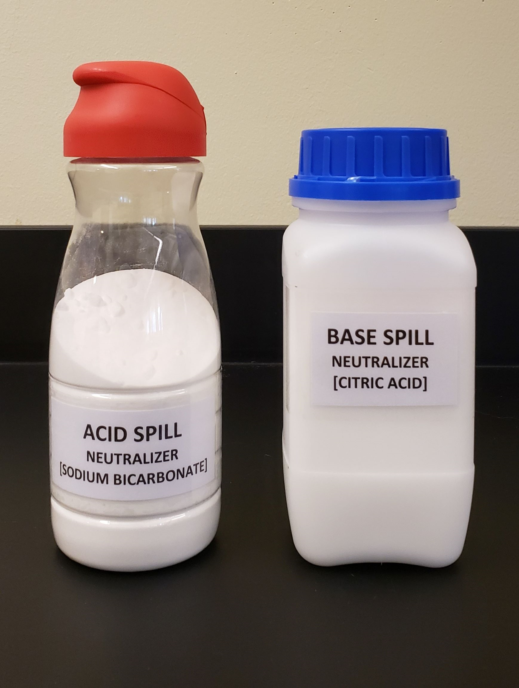
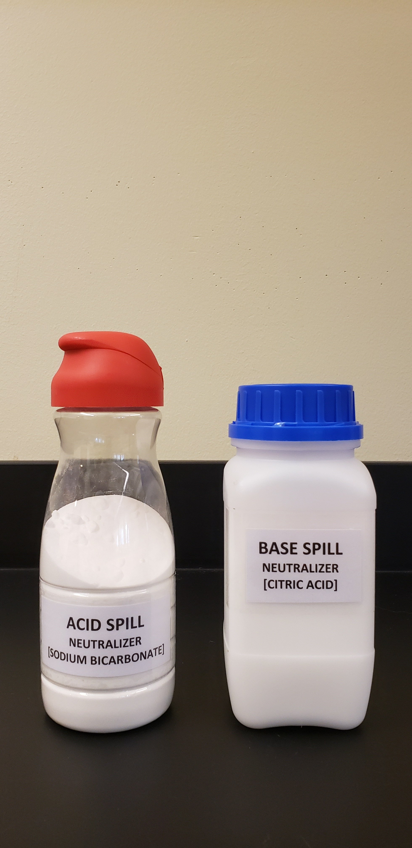
RAMP Concept – Prepare for Emergencies
Chemical Spills can be simple or complex.
Simple Spills
Simple spills: less than a Liter – clear spill zone.
Notify your TA or Professor, they will neutralize spills before starting to clean up.
Acid spills – use Sodium bicarbonate (Baking Soda)
Base spills – use Citric acid
Use plenty of paper towels for cleanup.
Notes:
Simple spills: less than a Liter. Clear Spill Zone. Notify your TA or Professor, they will neutralize spills before starting to clean up.
Acid spills – use Sodium bicarbonate (Baking Soda)
Base spills – use Citric acid
Use plenty of paper towels for cleanup.

Slide 35
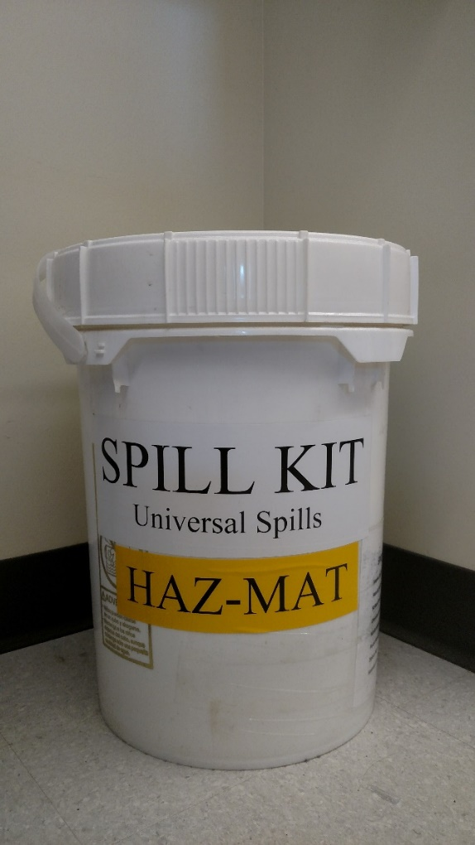
RAMP Concept – Prepare for Emergencies
Complex spills
Complex spills: (rare)
Can effect individuals or the environment, may require outside help for cleanup.
Remove ignition sources – if safe to do so.
Evacuate the room and wait for further instructions
Large Spills of: volatile chemicals
VERY RARE, IF properly handling containers. (two-hand method, secondary containment, cart with sides)
Notes:
Complex spills: (rare)
Can effect individuals or the environment, may require outside help for cleanup.
Remove ignition sources – if safe to do so.
Evacuate the room and wait for further instructions
Large Spills of:
volatile chemicals

Slide 36
If you need assistance or have any questions about the experiment or procedures please ask.
Perform all experiments in a safe manner, following safety procedures and techniques.
Remember to use the RAMP concept to:
Recognize hazards – know what your working with
Assess the risks of hazards – know route of exposure
Minimize risks – lower concentration, exposure time
Prepare for emergencies – know how to respond
We all have a role in working safely and minimizing risks.
Notes:
If you need assistance or have any questions about the experiment or procedures please ask.
We want you to be able perform all experiments in a safe manner, following safety procedures and techniques.
If you pay attention to details, follow instructions, use the RAMP concept to learn how to Recognize hazards, Assess the risks of hazards, Minimize risks by using control methods and procedures. Prepare for emergencies by knowing what steps to take to reduce harm or injuries and property damage. You will be able to work safely in any career that you choose.
We all have a role in working safely and minimizing risks in labs.

