Slide 1
2022 Employee Benefits

Slide 2
Agenda
Benefit Plan Overview
Onsite Clinic Reminder
HSA Education
Consumerism
Enrollment Process
Questions & Answers

Slide 3
Open Enrollment
Opportunity to make changes to your benefit elections and to review which dependents you will cover
Elections made during this period will remain in effect for a 12 month period, unless you experience an IRS-approved “qualifying event”
Approved qualifying events include:
Marriage or Divorce
Death
Birth or adoption of a dependent
Change in employment status
Change in dependent’s eligibility status
Loss of or significant change to your current coverage
Judgment, decree or court order
You have 30 days from the date of the event to notify Human Resources

Slide 4
Key Information
The 2022 Benefit Open Enrollment Period is November 1, 2021 – November 24, 2021
All benefit elections and changes will take effect January 1, 2022
The deadline to enroll is November 24, 2021

Slide 5
MEDICAL/RX
UMR / Optum

Slide 6
2022 Medical Renewal Great News - No Plan Design or Rate Changes!
St. Norbert College reserves the right to change the eligibility requirements at any time.
St. Norbert College’s medical plan requires that an employee’s spouse enroll in at least single medical coverage through his/her employer to serve as their primary insurance coverage or pay an additional surcharge to enroll or maintain enrollment in St. Norbert College’s medical plan as primary coverage. This additional surcharge is $50.00 twice a month ($1,200 annually)
Spouse Medical Insurance Coverage Statements previously completed will carry-over into 2022 unless you notify Human Resources of any changes to your spouses’ status as of January 1, 2022.

Slide 7
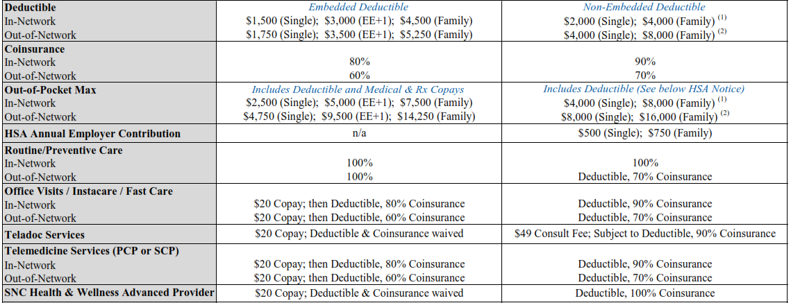
Benefit Highlights – Plan Year 1/1-12/31
IMPORTANT HSA PLAN NOTICE (In-Network): No individual family member's deductible is considered satisfied until the full family deductible has been met. However, no individual family member can exceed $6,550 in out-of-pocket expenses per year. The out-of-pocket limit for all family members combined remains at $8,000.
(2) IMPORTANT HSA PLAN NOTICE (Out-of-Network): No individual family member's deductible or out-of-pocket is considered satisfied until the full family deductible and out-of-pocket has been met.

Slide 8
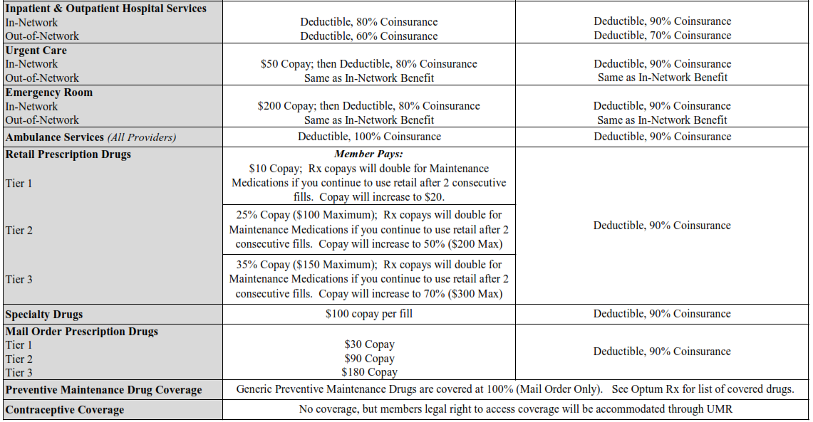
What are examples of preventive drugs: Medications used for diabetes (non-insulin), heart disease, cholesterol, blood pressure, blood thinner, and beta blockers.

Slide 10
Health Risk Assessments
St. Norbert College will no longer be offering voluntary confidential Health Risk Assessments (HRA)
Instead, please make sure you engage with your Primary Care Physician and take advantage of your preventive care covered at 100%.

Slide 11
EDUCATION
Health Savings Account

Slide 12
Health Savings Account (HSA)
What is a Health Savings Account (HSA)?
A health savings account (HSA) is an account that you can use to pay medical expenses.
This account helps offset your medical costs by giving you tax advantages, allowing your income to stretch farther by using the dollars that would have otherwise been paid in taxes.
BUT there are still a few rules:
You have to be eligible to have an HSA
You have to spend the dollars on qualified medical expenses and keep itemized receipts.
You can’t exceed the IRS max contribution limits

Slide 13
Are You Eligible for a HSA?
Are you covered on a Qualified High Deductible Health Plan? (HDHP)
SORRY!
Unfortunately you are not eligible for a Health Savings Account.
An HSA is a tax benefit that is heavily regulated by the IRS. There are certain requirements to be considered qualified to contribute pre-tax dollars.
You are still eligible to participate in the HDHP, but you are not eligible to fund a HSA to pay for out-of-pocket expenses.
Have you been enrolled on Medicare, Tricare, VA or HIS non-Preventive Medical/Rx plan within the last 3 months?
Are you claimed as a dependent on another person’s tax return?
Do you (OR YOUR SPOUSE) have a Flexible Spending Account (FSA)?
Is it a Limited Purpose FSA?
CONGRATULATIONS! It appears you are eligible to make pre-tax contributions into a Health Savings Account!

Slide 14
HSA: How Much Can I Contribute?
Individual Enrollment: $3,650
Family Enrollment: $7,300
St. Norbert College Contribution: $500 Single / $750 Family
Employer contributions will be deposited twice per year
Single: $333 (1st payroll in January); $167 (1st payroll in September)
Family: $500 (1st payroll in January); $250 (1st payroll in September)
Please remember:
These maximums should include any employer contributions.
Those 55 years and older and not enrolled in Medicare can contribute an additional $1,000 “catch-up” each year.
1/12th Rule may apply for mid-year plan enrollees

Slide 15
HSA: Who Can Spend the Dollars?
HSAs may reimburse any qualified health expense of the:
Account holder
(i.e. employee)
Account holder’s legal spouse
Any tax dependents
of the account holder

Slide 16
HSA: Things to Consider
While we can not recommend a plan for you, some things to consider when selecting your medical plan for 2022:
 | HDHP with HSA | Traditional PPO Plan
Would you rather pay more money as you incur services or pay more each pay period? | Least amount of money out of your paycheck – you will pay more when you incur services. | Most money out of your paycheck – set copays for many services.
Do you take expensive or several prescription drugs? | If yes, are you comfortable with paying 100% of the cost up to your deductible then the applicable co-pay up to the OOPM? | If yes, the deductible does not apply and there are set copays per prescription type.
Are you looking for a tax advantaged savings method? | If yes, this plan allows you to set aside money in an HSA that you can use for healthcare expenses or retirement. | If yes, this plan does not provide access to any special accounts like an HSA.
Are you covering a dependent on the medical coverage? | If yes, are you comfortable with the family non-embedded deductible and OOPM? | If yes, this plan has an embedded deductible.
Which plan is better? | Both are quality plans. It just depends on your financial point of view, medical needs and long-term financial goals and objectives. Both plans provide comprehensive coverage and include an out-of-pocket maximum (though the amount varies based on plan selection).

Slide 17
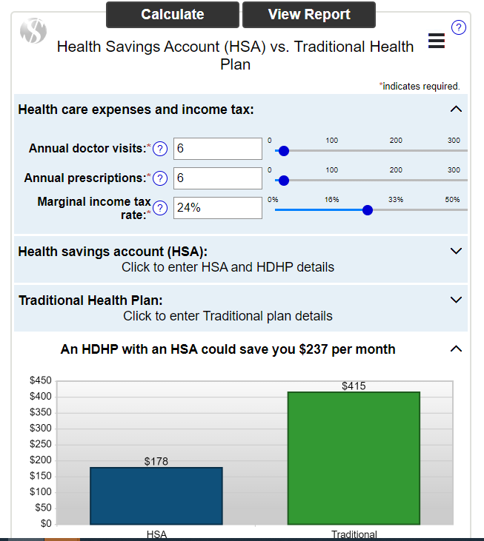
Which Plan Should I Choose?
Visit the link below:
https://www.aarp.org/health/medicare-insurance/hsa_calculator.html
Review your prior year’s medical expenses
Review your total claim costs
Ask yourself these questions:
Do I anticipate any surgeries or hospitalizations for me or my family in the upcoming year?
Do I take expensive prescription drugs?
Do I prefer a higher deductible with a lower payroll deduction?
Am I prepared to pay the high deductible in case of an unexpected medical event?

Slide 18
Flexible Spending Account
Healthcare FSA
Annual limit of $2,750 (capped per IRS regulations)
Pre-tax dollars used to pay for qualified medical, dental & vision expenses
Can’t be used in conjunction with an HSA
Limited flex (reimbursement for dental & vision expenses only) for those enrolled in the HDHP Plan (HSA)
$550 roll-over feature. Allows healthcare FSA participants to roll-over up to $550 of their previous year’s funds and add them to the new year plan. Rollover funds can only be used after the dollars from the new year’s plan have been used up. (Unused FSA funds in 2021 will roll-over into 2022). Elections needs to be made for the next plan year for rollover to occur.
Dependent Care FSA
Annual limit of $5,000 (pre-tax dollars used to pay for daycare expenses)
My Mobile Account Assistant (For Android and iPhones)
Camera scans documentation
Upload with claim information
Receive notification when a claim is processed
Expenses incurred in 2020 must have claims submitted by March 31, 2022

Slide 19
Using your benefits and getting care

Slide 20
Look up care where you live
Search by category:
People: Doctors and other health care providers
Places: Hospitals, clinics, imaging centers
Tests and Imaging: Lab tests, screenings, scans
Services and Treatments: Office visits, surgeries
Care by Condition: Area of the body, type of illness

Slide 21
Look for provider ratings for quality and cost
UnitedHealth Premium symbols look like this:
Premium Care Physician
Quality Care Physician
Quality Not Evaluated
Does Not Meet Quality
When you receive care from a Premium provider, you may pay less in out-of-pocket costs for your visit.
Notes:
UnitedHealthcare reviews health care providers in the network for how well they deliver quality and cost-effective care.
Premium Care Physicians are those who meet program criteria for quality & cost-efficient care
Quality Care Physicians are those who meet program criteria for providing quality care
Quality Not Evaluated means the specialty is not evaluated or the evaluation is in progress
Does Not Meet Quality indicates those that do not meet program criteria for providing quality care

Slide 22
See how much you’ll pay before you visit the doctor
With the health cost estimator you can:
Search for treatments or procedures from local providers
View estimates, including your out-of-pocket costs and what your plan will pay
Choose a provider and get a final estimate
Health cost estimator
Look for the shopping cart on umr.com

Slide 23
Choose the right health care setting
Ty­­­pe of care | Wait time | Cost**
Teladoc Consults by phone or online video for routine ailments.
17 minutes
Approximate wait time for doctor to respond
$49 per consultation
$50 - 100 Approximate cost per service
Retail clinic/convenient care clinic Clinics located in retail stores, supermarkets and pharmacies.
15 minutes
or less on average
Urgent care/walk-in clinic Urgent care centers, sometimes called walk-in clinics, are often open in the evenings and on weekends.
20 - 30 minutes Approximate wait time
$150 - $200 Average cost
Continued >>
Notes:
How much you pay and how long you wait may depend on where you go. Make sure you choose the right setting for your needs.
Use NurseLine to speak by phone with a registered nurse any time of day, seven days a week.
Call to get
- Help choosing the right health care setting for illness or injury
- Or information about common health problems or injuries
Use Teladoc to request a consultation from a board-certified doctor any time of day, seven days a week, by phone or online. Teladoc physicians can diagnose routine ailments, recommend treatments and prescribe medications.
Retail clinics, sometimes called convenient care clinics, are located in retail stores, supermarkets and pharmacies. They offer routine care for:
- Colds or Flu - Vaccinations or screenings - Sinus infections - Minor sprains, burns or rashes - Allergies - Headaches or sore throats
Urgent care centers, sometimes called walk-in clinics, are often open in the evenings and on weekends. They offer timely care for:
- Sprains and Strains - Minor broken bones or cuts - Mild asthma attacks - Minor infections or rashes - Sore throats - Earaches
Visit your doctor’s office for clinical care
Seeing your doctor is important. Your doctor knows your medical history and any ongoing health conditions.
See your doctor for:
- Preventive services and vaccinations
- Medical problems or symptoms that are not an immediate, serious threat to your health or life
Visit the ER only if you are badly hurt. If you are not seriously ill or hurt, you could wait hours and your health plan may not cover non-emergency ER visits.
Got to the ER for:
- Sudden change in vision - Heavy bleeding
- Sudden weakness or trouble talking - Spinal injuries
- Large, open wounds - Chest pain
- Difficulty breathing - Major burns
- Severe head injury - Major broken bones

Slide 24
Choose the right health care setting (cont.)
Ty­­­pe of care | Wait time | Cost**
Clinical care (your doctor’s office) See your primary care provider for preventive and ongoing care.
1 week
or longer for an appointment
$100 - $150 Average cost
Telehealth (electronic/virtual) Services provided through electronic communications, but not through a specific vendor.
Same day or more Approximate wait time for appointment
$100- $150 Average cost
Emergency room (ER) Visit the ER only for serious illnesses or injuries. Your health plan may not cover non-emergency ER visits.
3 - 12 hours
Approximate wait time for non-critical cases
$1,200 - $1,500 Average cost
**All costs are average and may not reflect your specific plan or choice in provider/vendor.
Notes:
How much you pay and how long you wait may depend on where you go. Make sure you choose the right setting for your needs.
Use NurseLine to speak by phone with a registered nurse any time of day, seven days a week.
Call to get
- Help choosing the right health care setting for illness or injury
- Or information about common health problems or injuries
Use Teladoc to request a consultation from a board-certified doctor any time of day, seven days a week, by phone or online. Teladoc physicians can diagnose routine ailments, recommend treatments and prescribe medications.
Retail clinics, sometimes called convenient care clinics, are located in retail stores, supermarkets and pharmacies. They offer routine care for:
- Colds or Flu - Vaccinations or screenings - Sinus infections - Minor sprains, burns or rashes - Allergies - Headaches or sore throats
Urgent care centers, sometimes called walk-in clinics, are often open in the evenings and on weekends. They offer timely care for:
- Sprains and Strains - Minor broken bones or cuts - Mild asthma attacks - Minor infections or rashes - Sore throats - Earaches
Visit your doctor’s office for clinical care
Seeing your doctor is important. Your doctor knows your medical history and any ongoing health conditions.
See your doctor for:
- Preventive services and vaccinations
- Medical problems or symptoms that are not an immediate, serious threat to your health or life
Visit the ER only if you are badly hurt. If you are not seriously ill or hurt, you could wait hours and your health plan may not cover non-emergency ER visits.
Got to the ER for:
- Sudden change in vision - Heavy bleeding
- Sudden weakness or trouble talking - Spinal injuries
- Large, open wounds - Chest pain
- Difficulty breathing - Major burns
- Severe head injury - Major broken bones

Slide 25
Telehealth and Telemedicine Vendor/Virtual Visit
Telehealth
Telehealth is a general term used to describe clinical services provided to patients through electronic communications not through a vendor. This can be patient-to-physician or physician-to-physician. Examples:
Patient is consulting with a specialist that is out of their geographical area
Patient has a virtual visit with their PCP
Telehealth is the use of digital information and communication technologies, such as computers and mobile devices, to access health care services remotely and manage your health care.
Telemedicine Vendor/Virtual Visit
Telemedicine vendor/virtual visit are general terms used to describe clinical services provided to patients via electronic communications through a vendor.
Examples:
Teladoc®
The program provides telephone and online video consultations with a physician and serves patients of all ages.

Slide 26
Talk to a doctor in 10 minutes anytime, anywhere
A virtual office visit for non-emergency care
Connect by phone, video or mobile app
24/7 assistance in 10 minutes
A network of qualified family physicians
Prescriptions sent to your pharmacy
Low-cost alternative to ER or urgent care
8

Slide 27
Go to Teladoc for these health issues
General health
Colds or flu
Allergies
Strains and sprains
Digestive issues
Sinus problems
Pediatric care
To get a consult:
Visit Teladoc.com
or call 1-800-Teladoc
(835-2362)
Your cost:
$49 HSA Plan $20 PPO Plan per general health consultation
9

Slide 28
31 Visits YTD
Average Wait Time = 16 minutes
Average savings of $468 per visit
St. Norbert College 2021 Stats
ACTION ITEM!
REGISTER NOW AND COMPLETE YOUR HEALTH QUESTIONAIRE IF YOU HAVE NOT DONE SO ALREADY
10

Slide 29
A digital ID card on umr.com
View your member ID information on your computer or mobile device
Have your doctor scan the on- screen bar code for your benefits information
Print a temporary replacement card
Fax a copy of your card to your doctor’s office
Continue to use current UMR ID card for 2022. You will receive a new ID card only if you are new to the UMR plan, or are adding/ removing any dependents from UMR coverage.
©2019 United HealthCare Services, Inc.
11
Proprietary information of United HealthCare Services, Inc. Do not distribute or reproduce without express permission of United HealthCare Services, Inc.

Slide 31
PPO Plan vs. HDHP/HSA Plan (OptumRx)
 | PPO Plan | HDHP Plan (HSA)
Deductible | No Deductible on Rx | Includes Medical & Rx $2,000 Single / $4,000 Family
Out-of-Pocket Maximum | Includes Medical & Rx $2,500 Single / $5,000 EE+1 $7,500 Family | Includes Medical & Rx $4,000 Single / $8,000 Family
Retail Copays / Coinsurance | Tier 1: $10 Copay Tier 2: 25% Copay ($100 Maximum) Tier 3: 35% Copay ($150 Maximum) Rx Copays / Maximums will double for Maintenance Medications if you continue to use retail after 2 consecutive fills. | Deductible, 90% Coinsurance
Mail Order Copays / Coinsurance | Tier 1: $30 Copay Tier 2: $90 Copay Tier 3: $180 Copay | Deductible, 90% Coinsurance
Specialty Drug Copays / Coinsurance | Tier 4: $100 Copay per Fill | Deductible, 90% Coinsurance
Generic Preventive Medication * | 100% Coverage when filled at Mail Order Only. Refer to the Optum Rx Preventive Medications List for a list of covered generic drugs.
* What are examples of preventive drugs: medications used for diabetes (non-insulin), heart disease, cholesterol, blood pressure, blood thinner and beta blockers.

Slide 32
Expanded Preventive List – Generic Medications
Your pharmacy benefit plan includes special coverage for generic preventive medications.
These medications help protect against or manage a medical condition, such as:
• Preventing blood clots and reducing the risk of a stroke
• Preventing heart disease and reducing high blood pressure
• Preventing osteoporosis (a disease that leads to an increased
risk of bone fracture)
Available on HSA and PPO Plan.
Medications on listing are $0 Copay (no deductible) when filled through OptumRx Home Delivery ONLY
Please reference the 2022 Expanded Preventive Medication Listing to see if your medication is on the list; generic medications are listed in lower case!
To switch your medication to OptumRx Home Delivery, please call Customer Service (# on the back of your ID Card) or visit optumrx.com

Slide 33
On call 24/7
Surrounding members with outstanding service
Customer Service Number – located on back of your ID Card!
End-to-end resolution with coordinated, proactive support.
At the heart of our operation are highly skilled Customer Service Advocates and pharmacists.
Experienced Team – Staffed with knowledgeable Customer Service Advocates
Award-Winning Training – Strong training program with tailored curriculum
Robust System – Customer Service Advocates are supported with innovative tools and a sophisticated communication system
Access 24/7 – Designated toll-free line, 24/7/365 access
Confidential property of Optum. Do not distribute or reproduce without express permission from Optum.

Slide 34
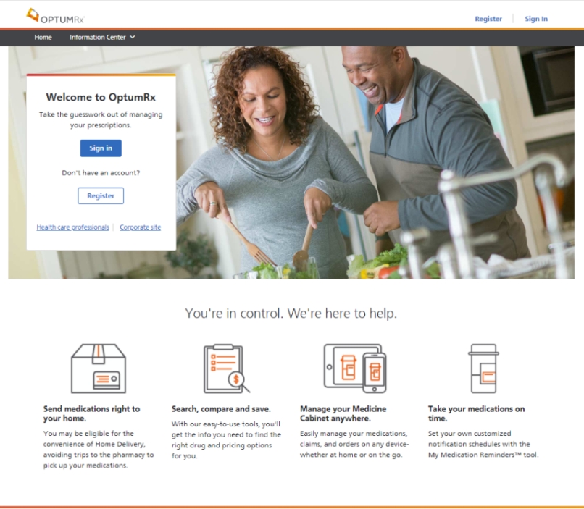
OptumRx consumer portal
Key features
Convenient, user-friendly tools help simplify and improve the consumer experience
Register or sign in to manage prescriptions
Today’s Portal features:
Order home delivery refills, renew and transfer prescriptions and track order status
Refill select specialty pharmacy medications
Release order holds online
Price medications and search for lower cost alternatives
Review pharmacy benefits, prescription drug list coverage, and claim history
Locate in-network pharmacies
Medication reminder enrollment
Manage household and caregiver access
Digital delivery of prescription Lit-packs
Improved Hassle Free Fill enrollment
Medications and benefits conveniently at your fingertips
Confidential property of Optum. Do not distribute or reproduce without express permission from Optum.

Slide 35
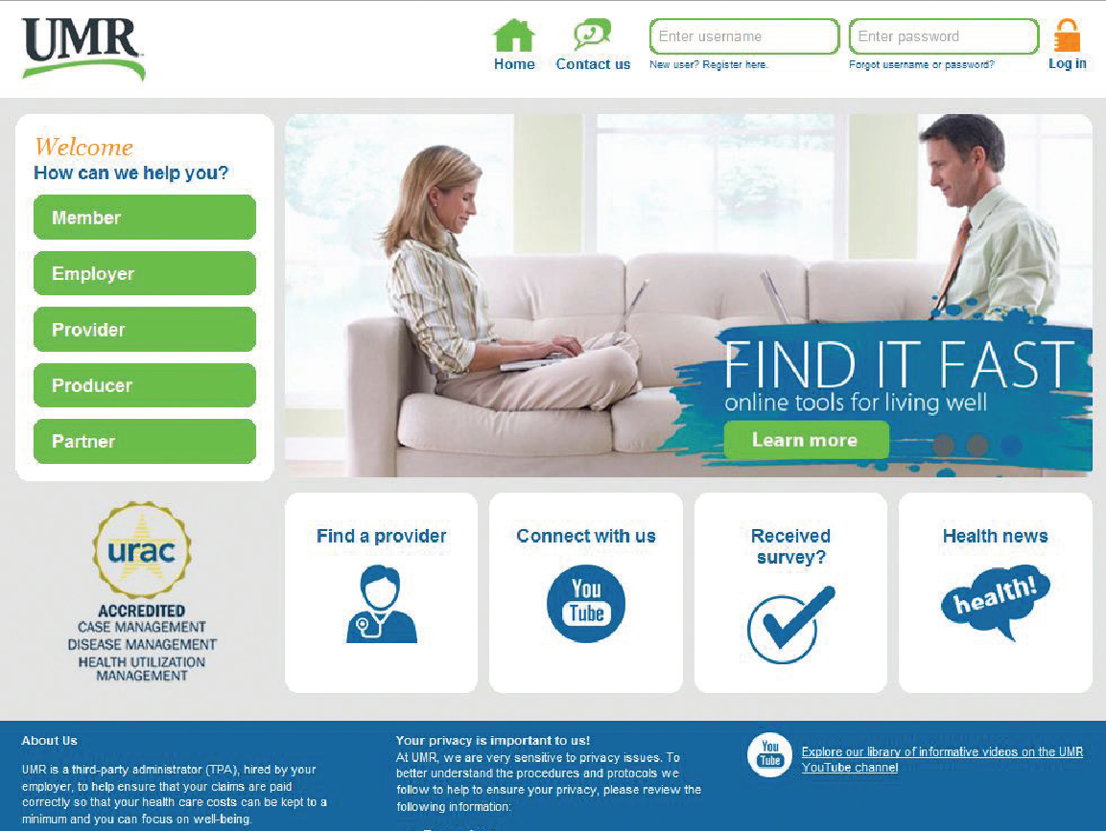
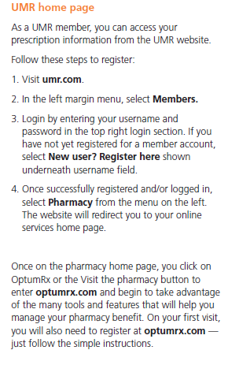
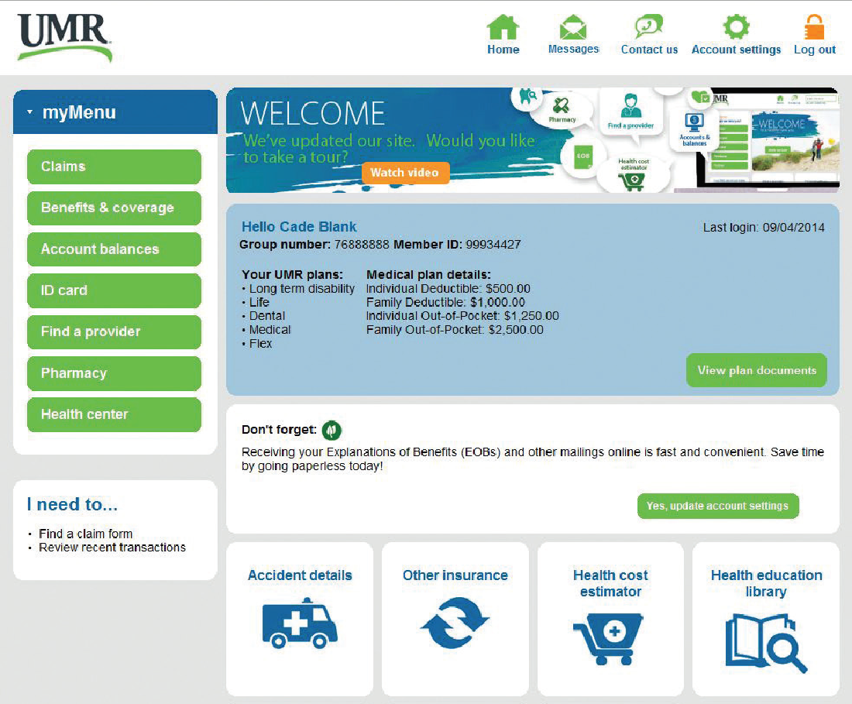
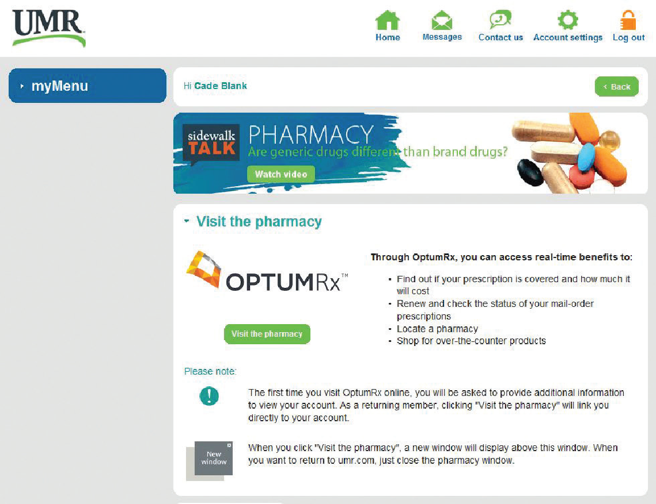
UMR – OptumRx Single Sign On

Slide 36
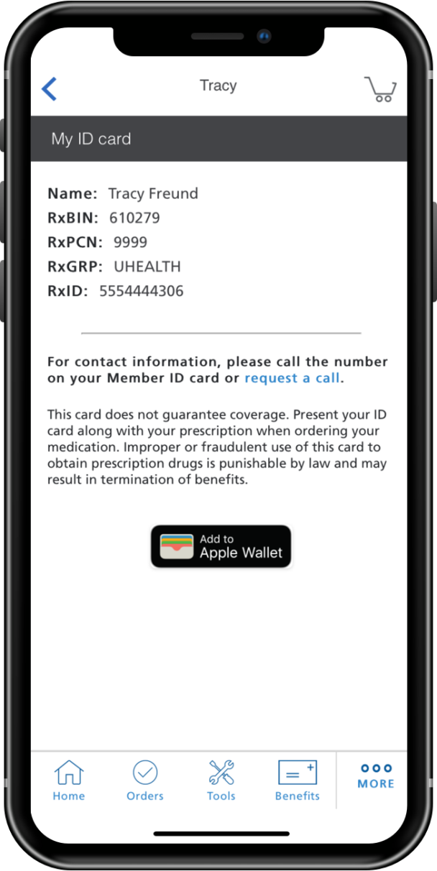
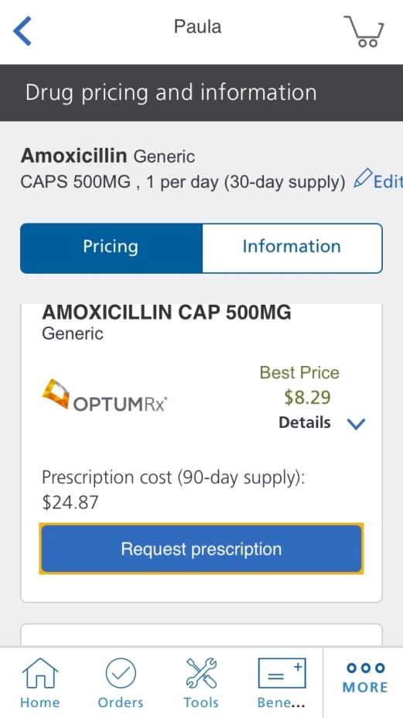
Drug Pricing Tool
Our digital precision pricing tool delivers greater pricing clarity, consistency, and transparency.
Precision pricing
Members can view targeted pricing specific to their benefits and compare medication options
Pricing transparency
Members know their cost before visiting the pharmacy or other purchasing avenues
1
Best-price option
To promote savings opportunities the Best-Price displays first
Offers savings opportunities
Identifies lower-cost alternatives based on members unique plan
0

Slide 37
ANCILLARY BENEFITS
Delta Dental & CarePlus

Slide 38
Dual Choice Dental Option – No Changes!
Care Plus Dental is offered along with Delta Dental
You have the option to choose what plan is best for you and your family.
No Changes to Current Plan Design
No Change to Employee Premiums for 2022
Care Plus
Provides a lower premium option with increased employee benefits.
HMO Dental Plan Only. You must use a Dental Associate or Midwest Dental Provider.
Delta Dental
Expansive Network of Providers throughout WI and the US
Offers Evidence-Based Integrated Care for those who require additional cleanings due to certain medical conditions.
If you wish to continue your current coverage with Delta Dental or CarePlus, no enrollment forms are needed.

Slide 39
Dental Benefit Highlights

Slide 40
ADDITIONAL BENEFITS AVAILABLE!
New Effective 1/1/22

Slide 41
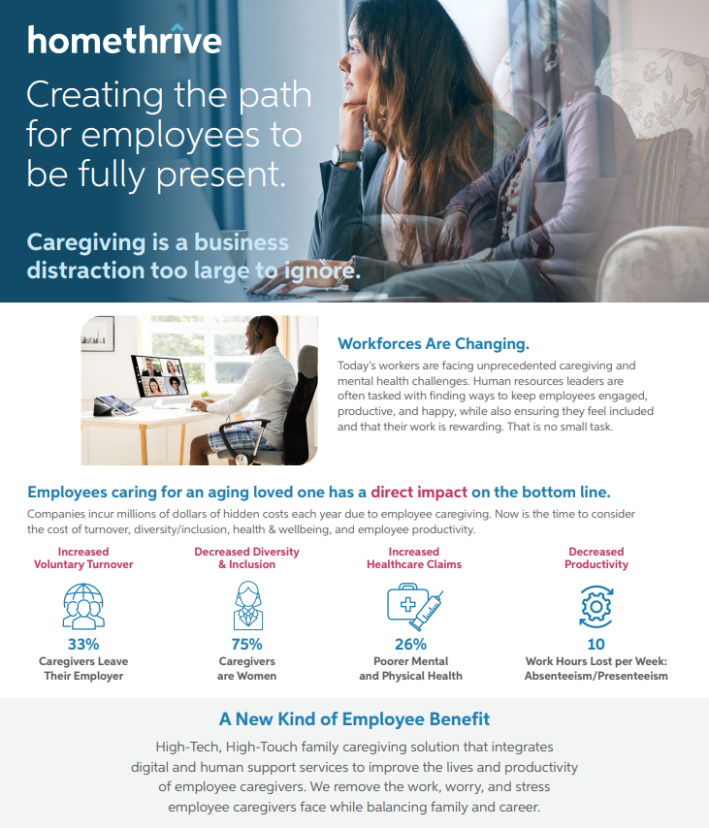

Slide 43
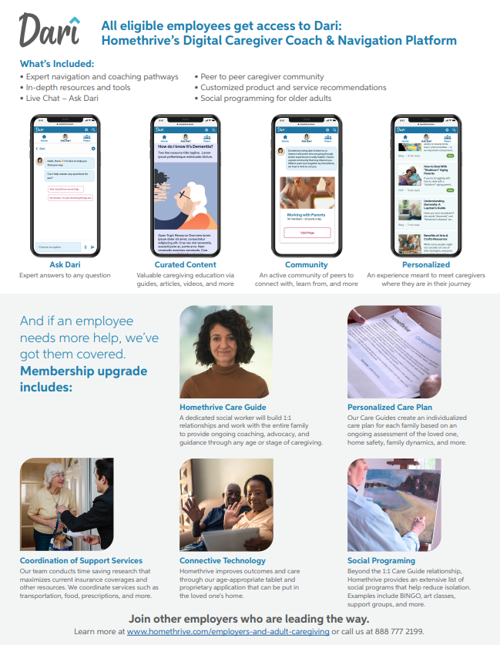
Please Note:
Dari is available to everyone even if you don’t elect the personalized service for $99/month.
*

Slide 44
LIFELOCK WITH NORTON BENEFIT PLANS: ST. NORBERT COLLEGE NEW MEMBER OVERVIEW / EXPERIENCE
Notes:
I want to THANK you for viewing this presentation… Bobbi, USI Benefits team and of course Jesse Albers Ben Specialist at SNC
Our goal is to share THE new member experience and activation process for your LifeLock with Norton Benefit . I will be touching on the benefit features and how to ACTIVATE Your LifeLock w/ Norton Account – TO successfully log-in to your NEW Benefit
Lauren Robinson

Slide 45
Combating Real Threats
The Threat.
Our Solution.
Identity | Unemployment Fraud | LifeLock Restoration Team
 | Credit Card Opened in Your Name | LifeLock Identity Alerts and/or Credit Application Alerts
Device Security | Phishing e-mail + texts execute malware on computer | Norton Device Protection
 | Password used at home & work | Password Manager
Online Privacy | Shopping online with a credit card stored on your device | VPN
 | Video camera uncovered and used often | PC SafeCam
Home & Family | Children stumble into inappropriate web content | Parental Controls
 | Children discussing sensitive, self harm words on social media | Social Media Monitoring
Copyright © 2021 NortonLifeLock Inc. All rights reserved.
Notes:
This slide helps reflect HOW our 4-Piller Focus is a Solutions for the everyday threats we all are facing.

Slide 46
LifeLock with Norton Benefit Plans Overview
COMPLETE
Both Products Include:
LifeLock Identity Protection
LifeLock Identity Alert System
Prior ID Theft Remediation
*Privacy Monitor
Dark Web Monitoring
$1m Guarantee(s)
Financial Account Activity Alerts
ID Verification Alerts
Lost Wallet Protection
Credit Freeze/Lock
Social Media Monitoring -NEW 1/2021
Norton
Norton Device/Online Security
Norton Parental Controls
Norton Password Manager
Safecam
Secure VPN- new 3/2021
All Benefit Essential Features +
3 Bureau Credit Monitoring
3 Bureau Report + Score
Monthly Credit Score Tracking
Norton Device Protection (5EE/10FM)
Online Backup (50GB)
Bank Account Takeover Alerts
New Checking & Savings Application
Home Title Monitoring
1 Bureau Credit Monitoring
1 Bureau Report + Score
1 Bureau Credit Application Alerts
Norton Device Protection (3EE/6FM)
Online Backup (10GB)
Monthly
$7.99/pp Employee
$15.98/pp Employee+
Monthly
$11.49/pp Employee
$21.98/pp Employee+
Notes:
Now I want to take a minute to talk about the plans offered to you… YOUR Employee Flyer was Attached to the Invite with a FULL checklist of features and pricing but just want to touch on the Plans available AND differences of both Benefit Essential & Benefit Premier…

Slide 47
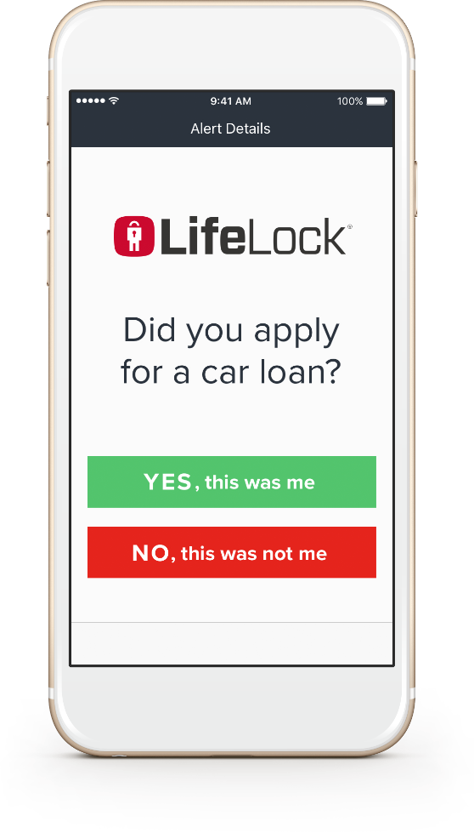
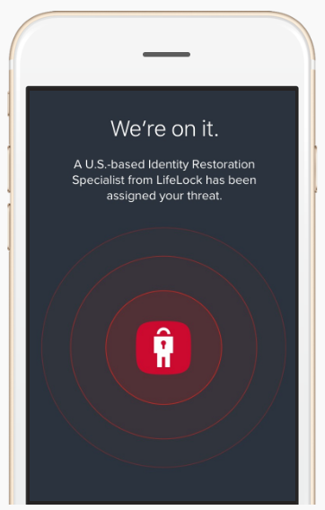
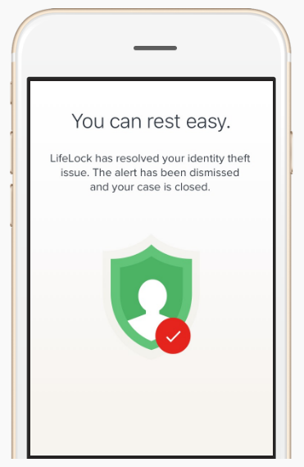
How LifeLock Works
WE SCAN
We look for threats to your identity.
WE ALERT†
We alert you of suspicious threats by text, email, or phone. ††
WE RESTORE
If your identity is stolen, our U.S. based team will work to fix it.
WE REIMBURSE
We’ll reimburse funds stolen due to identity theft up to the limit of your plan. ‡
Notes:
I like to show you what those initial alerts will look like- Letting you know it is a SIMPLE YES or NO response from you. THESE come vis text, email or IVR call based on enrollment information shared… If it is YES, we are all good, If it is No, then we have the ability stop or close the account as it’s happening- in many cases BEFORE an Acct Balance in incurred.

Slide 48
MONEY SAVING TIPS
Consumerism

Slide 49
How Can You Control Costs & Maximize Your Benefits?
See in-network providers and get carrier discounts
Use generic Rx & shop around for best pricing
Use urgent care clinic vs. ER
Get annual preventive medical & dental check-ups
Use Virtual Visits
Know your benefit plan and where you stand in regards to your deductible / OOP Max
Use the NurseLine
Review your EOB’s and compare to your provider charges
Get a flu shot
Use your benefits wisely
Take advantage of pre-tax dollars through your FSA or HSA

Slide 50
ENROLLMENT PROCESS
St. Norbert College

Slide 51
Required Forms To Be Completed
Deadline for enrollment forms is November 24, 2021. Please return completed forms to your Human Resources Department.
UMR enrollment form: Needed for new enrollees, adding/removing dependents, dropping coverage, plan election changes
Not required if you are keeping your current coverage
Spouse medical insurance coverage statement
Required if your spouse has any change in medical coverage available to them through his/her employer’s plan.
Associated Bank Health Savings Account (for those enrolling in the HDHP/HSA Plan)
Complete application and applicable forms to open your HSA bank account and start contributing!
Delta Dental and Care Plus Dental enrollment form: Needed for new enrollees, adding/removing dependents only, dropping coverage
Not required if you are keeping your current coverage
EBC – online FSA enrollment form: Needed for all participating. Enrollment does not carry over. All employees who wish to participate MUST enroll again for 2022

Slide 52
Thank you for your participation in this year’s open enrollment presentation.
All election changes are due by: November 24th
© 2020 USI Insurance Services. All rights reserved.

